Slide 1


CEU Cardenal Herrera University – Valencia, Spain
INTERSENO 2026
COGNITIVE ACCESSIBILITY IN MEDIA INFORMATION FOR OLDER ADULTS WITH MILD COGNITIVE IMPAIRMENT: BARRIERS AND ADAPTATION STRATEGIES
Autor:
Supervisors:
Paula Hernández
José Antonio Solves
MªPilar Paricio

Slide 2
INDEX
01
01 Introduction & Context
05
Hypotheses
02
Theoretical Framework
06
Methodology
03
Objectives
07
Results
04
08
Research Question
Conclusions & Implications

Slide 3
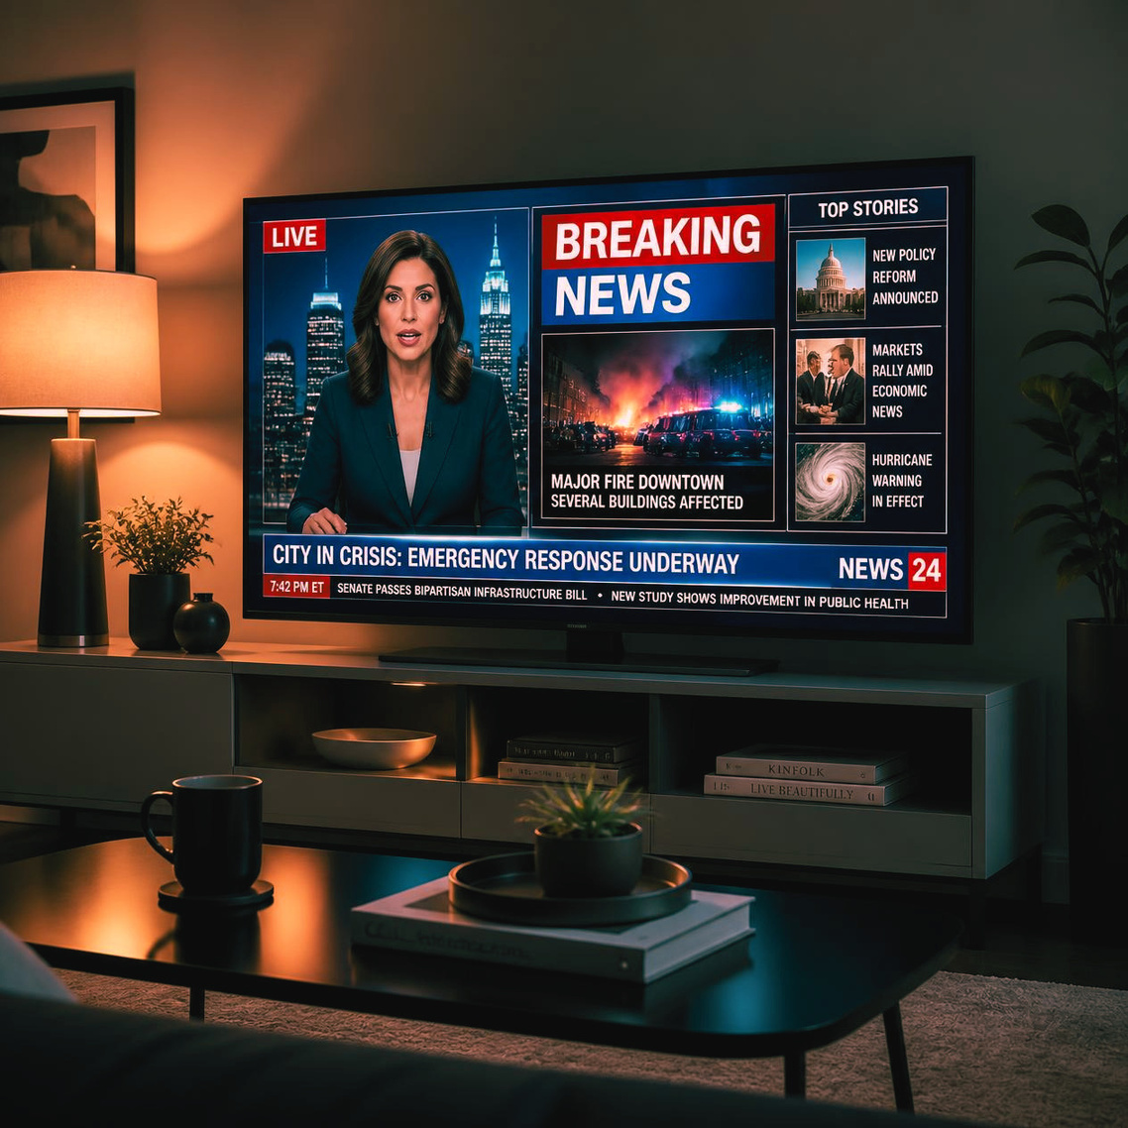
INTRODUCTION AND CONTEXT
Why does this matter?
• Older adults with MCI face difficulties in understanding information.
• Current media are mainly accessible from a sensory perspective.
• Cognitive accessibility remains largely overlooked.
• Understanding information is essential for autonomy and participation.

Slide 4
THEORETICAL FRAMEWORK
Concepts:
Previous research
• Mild Cognitive Impairment: Memory, attention and comprehension difficulties
(Petersen 2009; Albert 2011).
• Cognitive Reserve: Cognitive activity may delay decline (Stern 2012; Wilson 2013; Livingston 2020).
• Right to Information: Information enables participation and citizenship
(Habermas 1991; UN 2007; Council of Europe 1950).
  Cognitive Accessibility: Information should be understandable, not only available.
  Digital Media: Older adults face cognitive and digital barriers. Information overload, Fast communication, Digital inequalities (Nimrod 2017; Petrovčič 2023)
  Research Gap: Limited evidence on cognitive accessibility in media.

Slide 5
OBJETIVES
Analyse perceptions of information accessibility for older adults with MCI.
General objective
SO1
Identify comprehension barriers.
SO2
Identify adaptation strategies.
SO3
Compare the perspectives of experts, professionals and families.

Slide 6
RESEARCH QUESTION + HYPOTHESES
H1
H2
H3
Main barriers concern comprehension rather than access.
Plain language and structured information improve accessibility.
Stakeholders largely agree on barriers and solutions.
Research Question: How is information accessibility configured for older adults with MCI?

Slide 7
ALIGNMENT OF THE STUDY
Objective | Hypothesis | Method
General objective | H1-H3 | Focus groups
SO1. Identify comprehension barriers | H1 | Thematic analysis
SO2. Identify adaptation strategies | H2 | Axial coding
SO3. Compare stakeholders' perspectives | H3 | Comparative discourse analysis

Slide 8
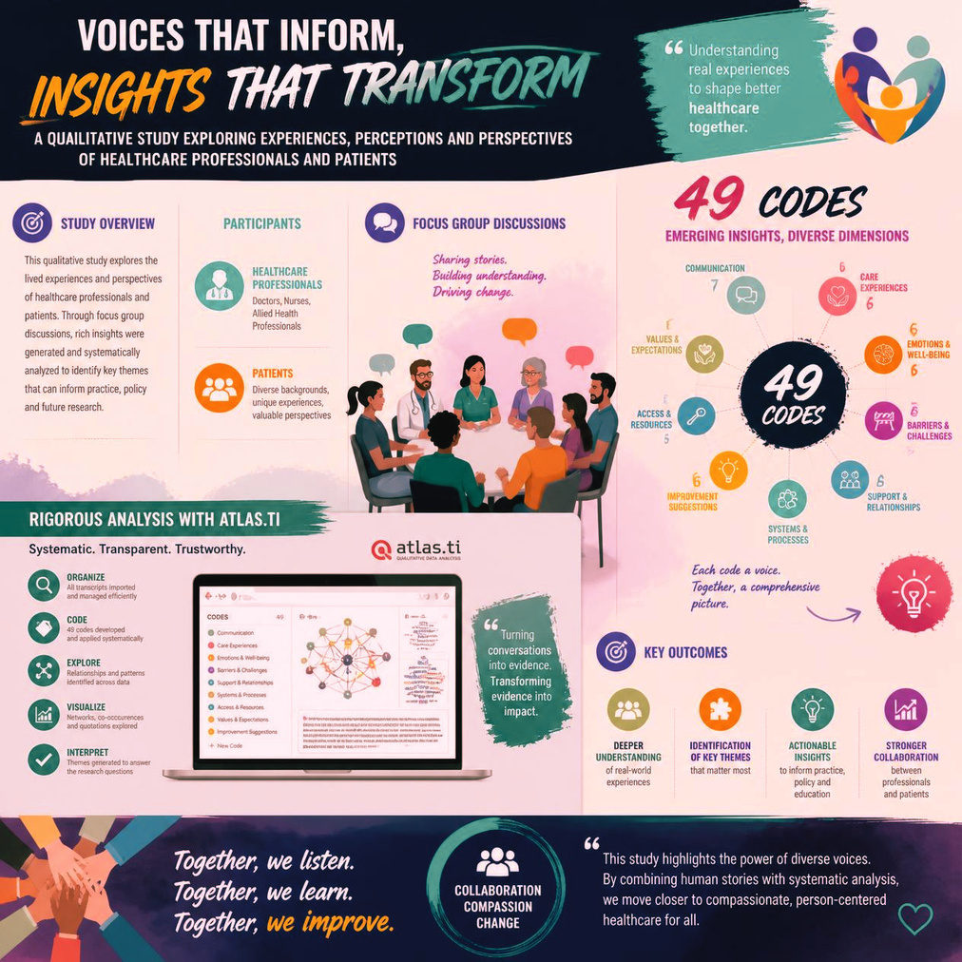
METHODOLOGY
Design: Qualitative study
Technique: 3 Focus Groups
Analysis:
  Atlas.ti
  Thematic coding
  Axial analysis
Data: High discursive convergence
  49 codes
  2,200 coded quotations

Slide 9
PARTICIPANTS & DATA COLLECTION
Focus group | Participants | Profile | Duration | Location
FG1 | 8 | Experts in communication, accessibility and disability | 95 min | CEU Cardenal Herrera University
FG2 | 8 | Healthcare professionals | 30 min | La Fe University and Polytechnic Hospital
FG3 | 9 | Older adults with MCI, relatives and caregivers | 47 min | AFAV (Valencia Alzheimer's Association)

Slide 10

RESULTS I
Lack of user-centred design:
• Information overload
• Fast pace
• Complex language
• Lack of structure
Quotes:
  “Cognitive accessibility is the invisible one that cannot be seen.” (P7, FG1)
  “Communication moves so fast… and especially if you no longer have the same abilities you had years ago…” (P3, FG2)
  “Television overwhelms me and I cannot understand it.” (P1, FG3)

Slide 11
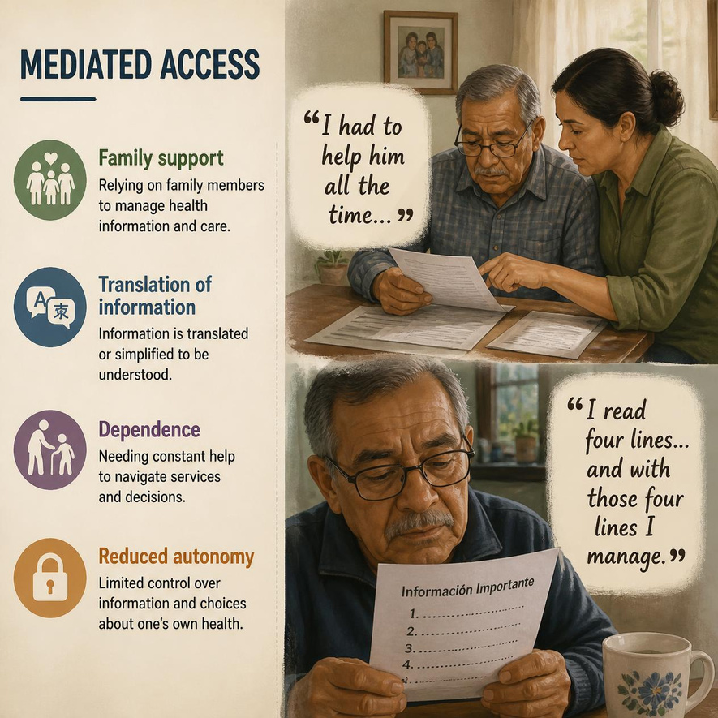
RESULTS II
Mediated access:
• Family support
• Translation of information
• Dependence
• Reduced autonomy
Quotes:
  “I had to help him all the time…” (P2, FG3)
  “I read four lines… and with those four lines I manage.”
  (P4, FG3)

Slide 12
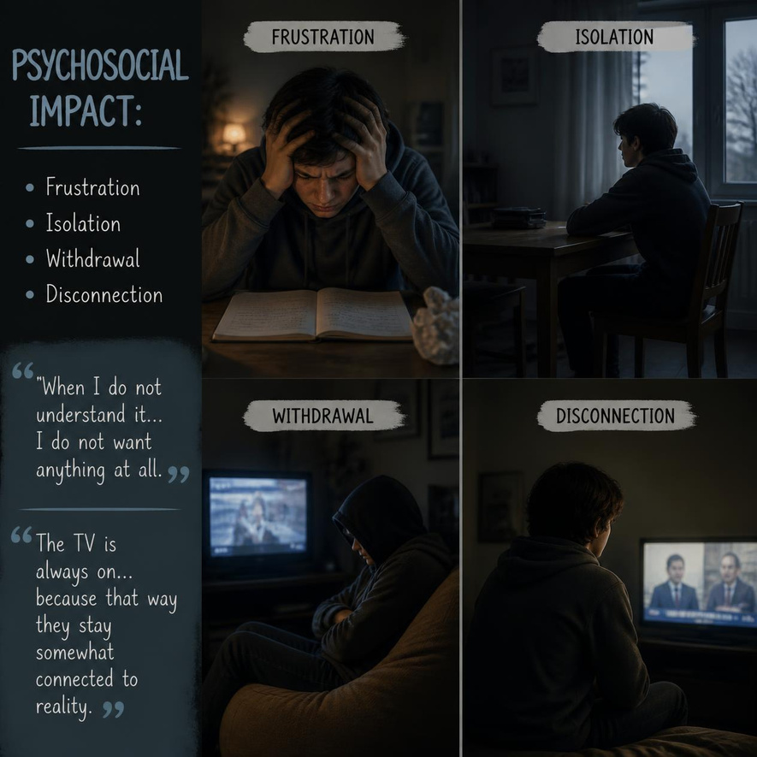
RESULTS III
Psychosocial impact:
• Frustration
• Isolation
• Withdrawal
• Disconnection
Quotes:
  “When I do not understand it… I do not want anything at all.” (P1, FG3)
  “The TV is always on… because that way they stay somewhat connected to reality.” (P5, FG3)

Slide 13
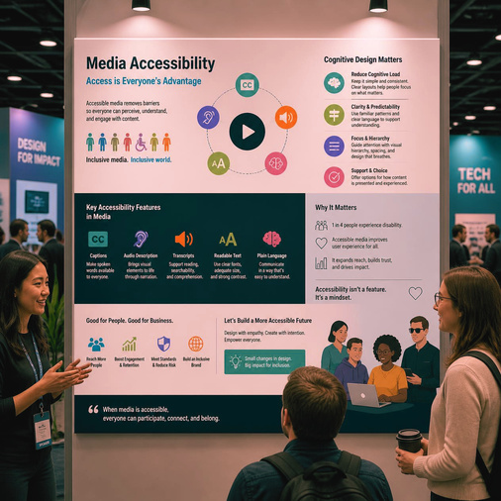

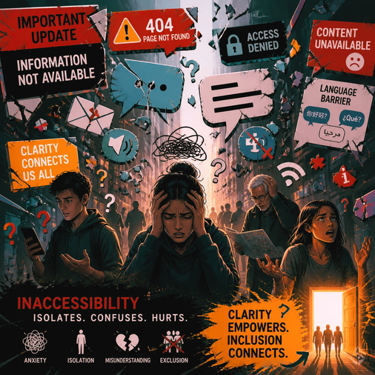
MAIN CONCLUSIONS
01
02
03
Media are not designed according to cognitive accessibility criteria.
Access depends excessively on human support.
Informational inaccessibility has emotional and social consequences.

Slide 14
ACHIEVEMENT OF RESEARCH OBJECTIVES
Objective | Hypothesis | Main finding
SO1. Identify comprehension barriers. | H1. Barriers are mainly related to comprehension rather than access. | Confirmed. Linguistic complexity, information overload and fast-paced communication emerged as the main barriers.
SO2. Examine adaptation strategies. | H2. Plain language and structured information improve accessibility. | Confirmed. Participants consistently highlighted simplification, repetition and structured content as the most effective strategies.
SO3. Compare stakeholders' perspectives. | H3. Different groups share similar perceptions. | Largely confirmed. Experts, healthcare professionals and families showed a high degree of convergence despite their different perspectives.

Slide 15


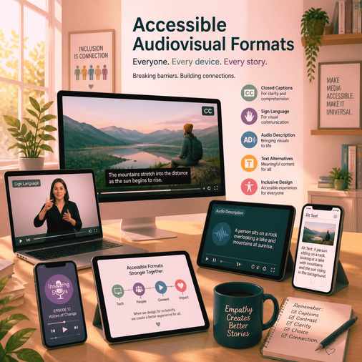
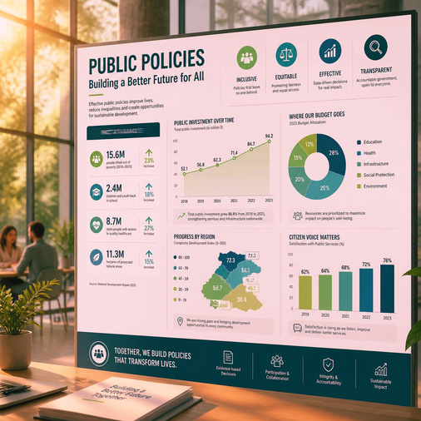
IMPLICATIONS
01
02
03
04
User-centred communication
Plain language
Accessible audiovisual formats
Public policies

Slide 16
CEU CARDENAL HERRERA UNIVERSITY
THANK YOU
By
Mail
Paula Hernández Burguete
paula.hernandezburguete@uchceu.es

