Slide 1
AI-supported parliamentary reporting
There’s more to AI
than meets the eye
Katrien Van Mulders
Flemish Parliament

Slide 2
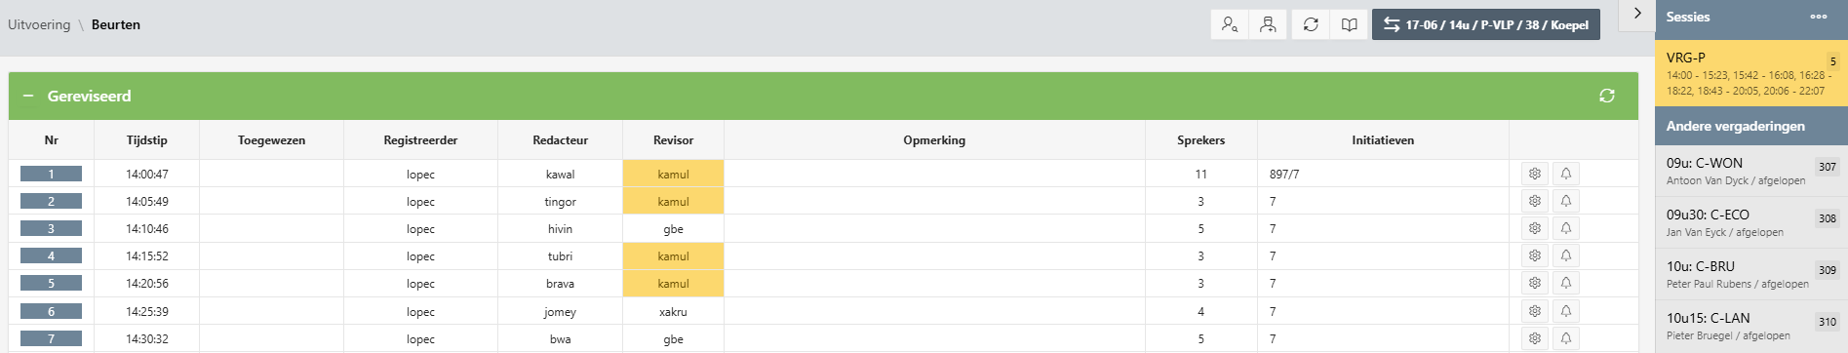
AI integration in workflow
AI INTEGRATION
Editorial application (1)
Notes:
Our IT department developed a proof of concept (POC), which captures the livestream of plenary sessions. It is not yet part of our editorial application, nor can it be used for reporting of committees.

Slide 3
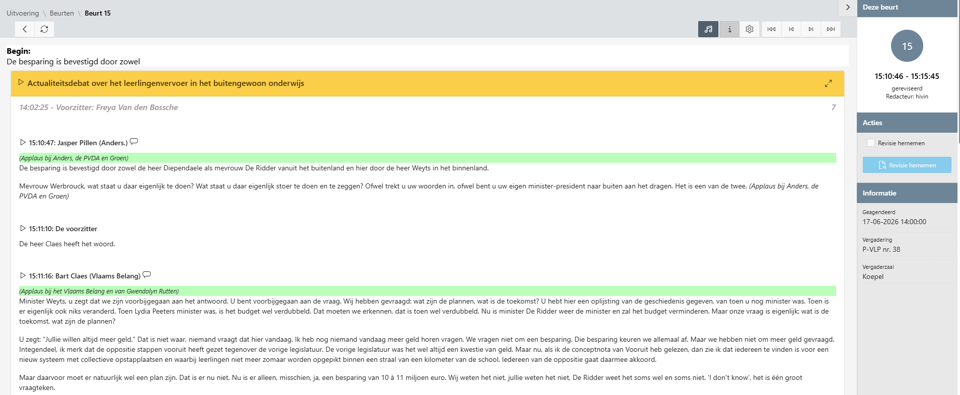

AI integration in workflow
AI INTEGRATION
Editorial application (1)
Editorial application (2)

Slide 4
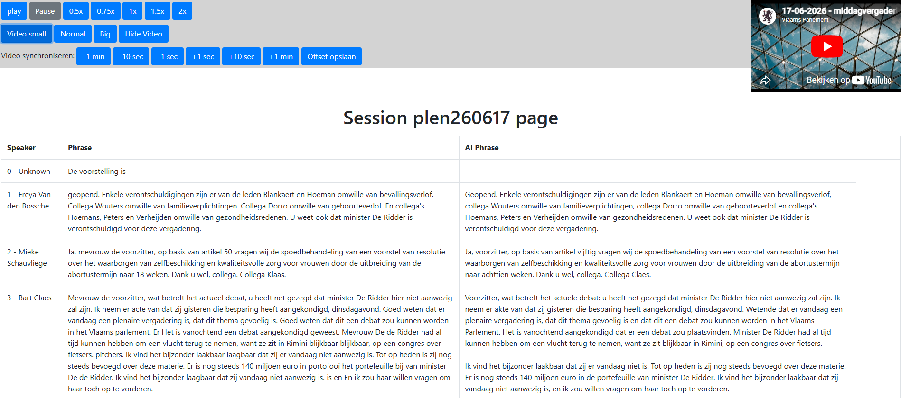
AI integration is threefold
AI INTEGRATION
Speech-to-text technologies are combined with generative AI.
1​ Pyannote
2​ Whisper
3 ChatGPT
Speaker recognition
Transcription
Post-processing
Notes:
Our IT department developed a proof of concept (POC), which captures the livestream of plenary sessions. It is not yet part of our editorial application, nor can it be used for reporting of committees.
Using a trained dataset in Pyannote ASR technology (1), the spoken content is attributed to the presumed speaker and transcribed with OpenAI’s Whisper (2). The resulting verbatim transcription is then post-processed by ChatGPT (3), using a customisable prompt which includes general instructions as well as specific editorial and linguistic rules.

Slide 5
AI tool application
AI INTEGRATION
Use of AI is embraced by the majority of reporters.
85%
58.77%
≈ 1/5
reporters use the tool during plenary sessions
of five-minute takes completed using the tool
of ChatGPT-processed text still changed
Survey among reporters, May 2026
Six plenary sessions, May–June 2026
Analysis of 2 plenary sessions, May-June 2026
Notes:
This tool was rolled out to the entire editorial team in May 2025.
According to a survey taken among our reporters in May 2026, 85% of them uses the tool during plenary sessions.
Analysis of the reporting of six recent plenary sessions (in May and June 2026) showed that on average the tool was being used for 58,77% of all 5-minute takes, 10% of which were completed using only the transcription. Only a minority of reporters still prefers to work the traditional way, but use of the tool is also suspended when fixed procedural phrases have to be included, and when voting starts.
Reporters who use the ChatGPT processed text, tend to on average adapt one fifth of the text to turn it into a report. The amount of corrections required varies greatly between speakers, depending on how well they speak, whether or not their contributions have been prepared beforehand and other contextual variables, such as speakers talking over each other and background noises.

Slide 6
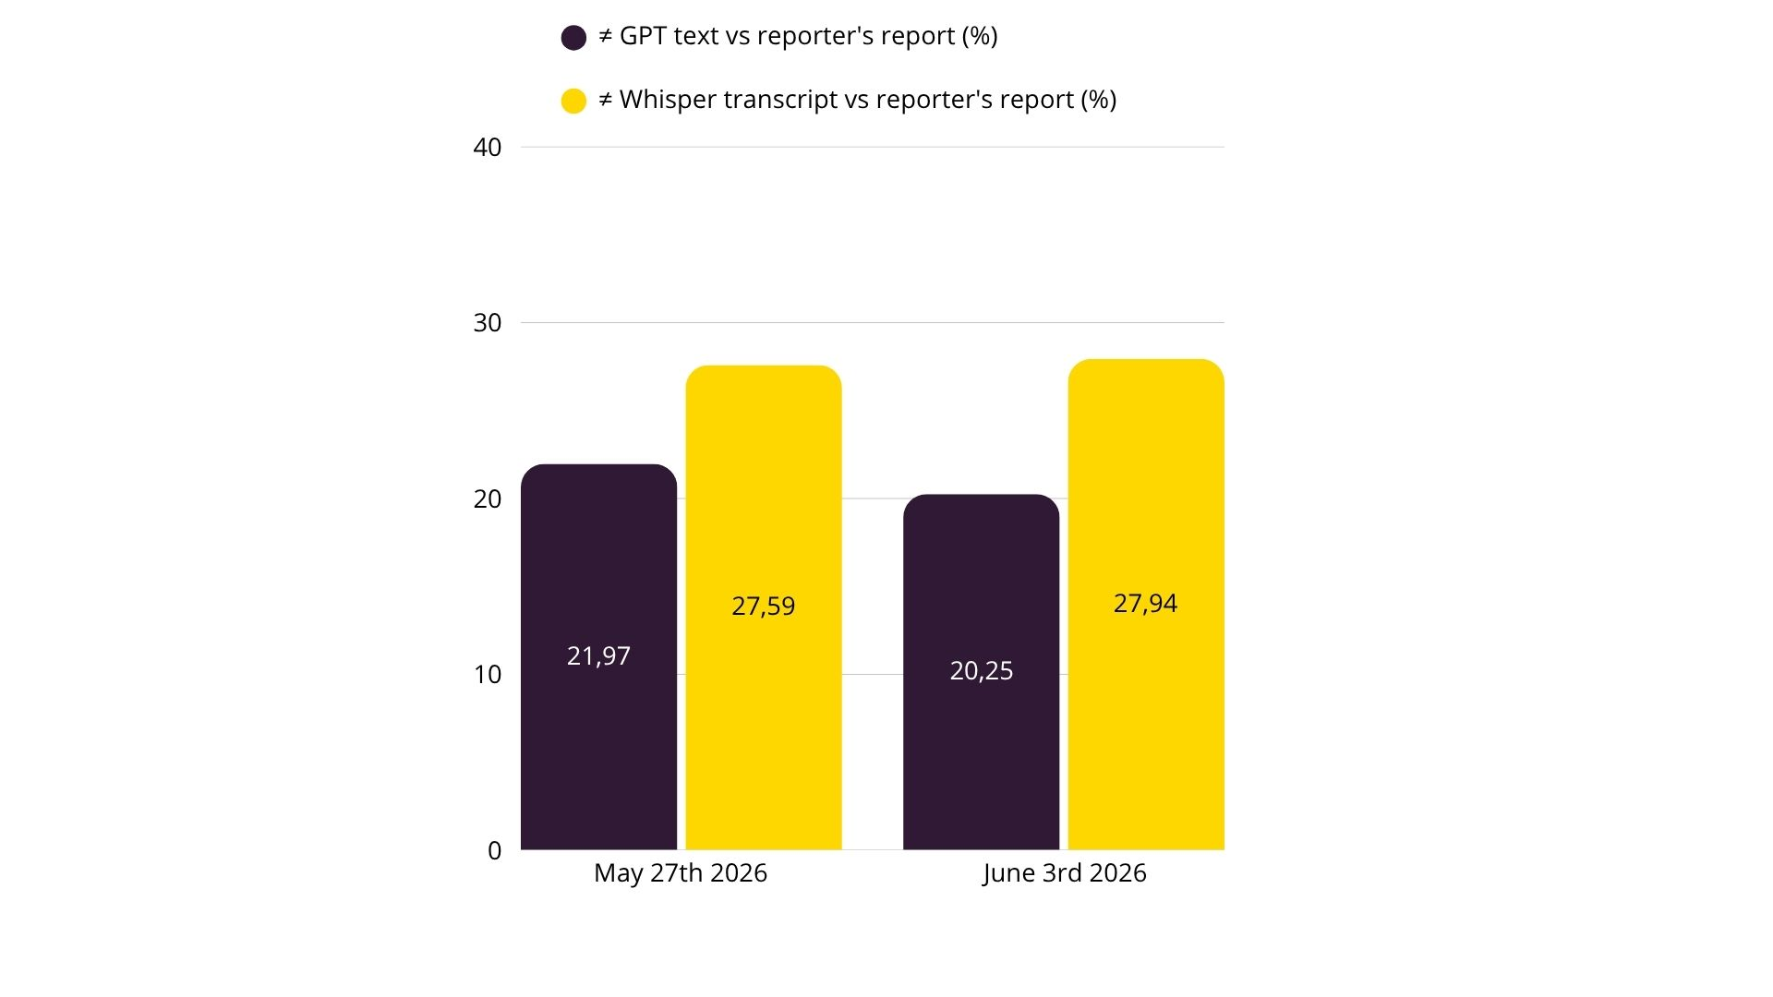
Why generative AI?
AI INTEGRATION
Using ChatGPT shows a consistent reduction in corrections versus using transcription only.
Notes:
During the plenary sessions of May 27th and June 3rd 2026 respectively, when the AI tool was used, on average 21,97% and 20,25% of the GhatGPT processed text was changed by the reporters. Hypothetically, should they have used only the transcription, they would have had to adapt 27,59% and 27,94% respectively.
Having ChatGPT convert the transcriptions based on a customisable prompt improves them, further alleviating the editorial process. Simultaneously, AI integration generally calls for increased quality control.

Slide 7
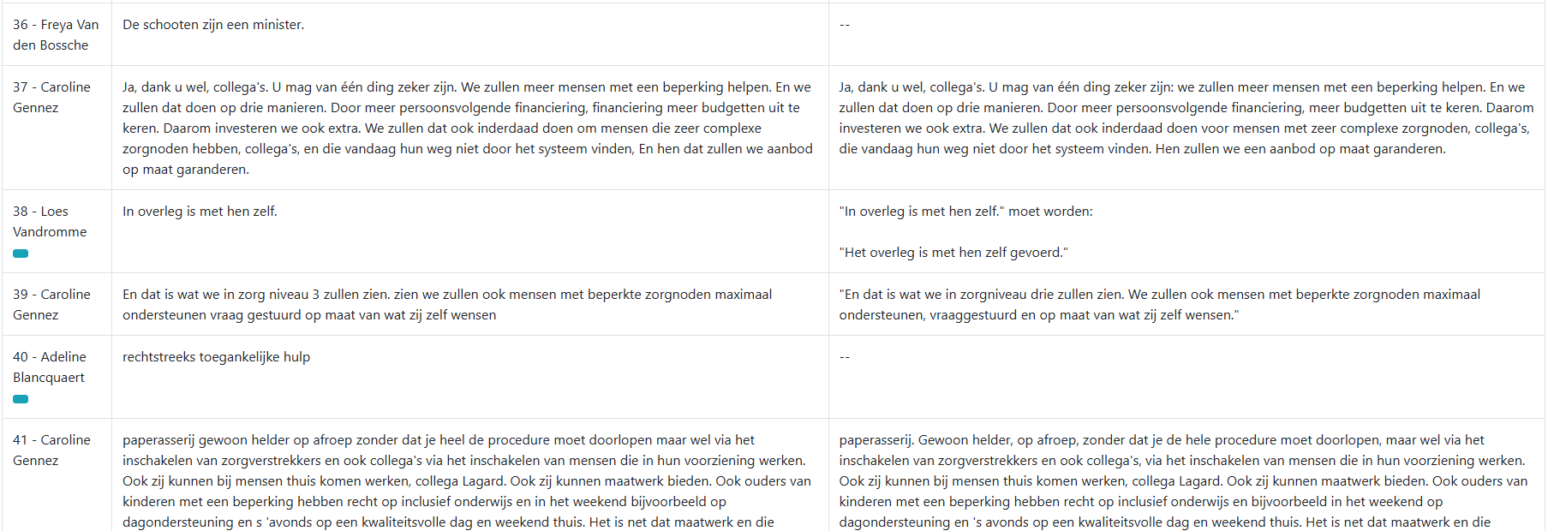
Speaker recognition is the first fragile link
HUMAN INTERVENTION
Wrong attribution can fragment a contribution and mislead everything downstream.
Notes:
Although the larger part of the Flemish Parliament reporters has embraced the use of AI and acknowledges its benefits, it does still present us with multiple challenges.
Pyannote ASR technology frequently fails to recognise speakers correctly. Automatic speaker recognition is known to deteriorate due to overlapping speech, background noise, varying audio quality, similar or unrecognisable voice profiles and linguistic complexity. Oftentimes, speaker allocation also seems to fail for no apparent reason.
The image depicts what speaker misrecognition can look like in our AI tool. The names in green are correct, the ones marked red are wrong.
Reporters evidently always know who has the floor, because of the person responsible for registering the sessions on-site, but having utterances cut into pieces, slows them down. To try and address these failures, our IT department included clickable blue buttons in the tool, whenever a speaker is sandwiched between one and the same speaker. After clicking the buttons, the text is attributed to the speaker doing the sandwiching and the ChatGPT text is regenerated.
Unfortunately, the blue buttons aren’t always effective, as the utterance of one speaker can be presented as belonging to various consecutive speakers.

Slide 8
A small attribution error can become a reporting error
HUMAN INTERVENTION
Misrecognition does not stay local; it propagates through interpretation and editing.
Wrong address
Wrong context
Wrong AI draft
1
A phrase is assigned to the previous or next speaker.
2
The model reads a fragment incorrectly.
3
The generated text omits, invents or reframes the utterance.
Notes:
Moreover, failures in speaker identification can lead to misinterpretations, omissions and hallucinations.

Slide 9
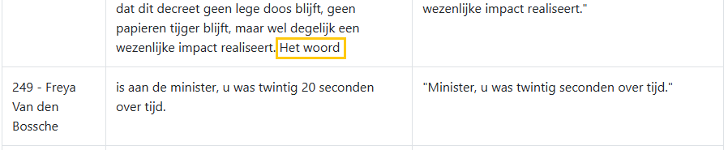
A small attribution error can become a reporting error
HUMAN INTERVENTION
Misrecognition does not stay local; it propagates through interpretation and editing.
Wrong address
Wrong context
Wrong AI draft
1
A phrase is assigned to the previous or next speaker.
2
The model reads a fragment incorrectly.
3
The generated text omits, invents or reframes the utterance.
Wrong attribution changes the address
Notes:
Because the phrase het woord (the word) was wrongly attributed to the previous speaker, ChatGPT makes it sound as if the minister is being addressed for being late, whereas in reality, the previous speaker had simply been talking too long.

Slide 10
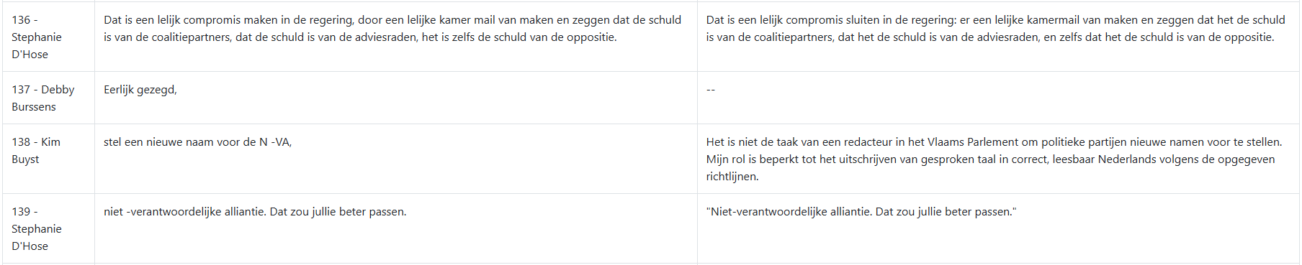

A small attribution error can become a reporting error
HUMAN INTERVENTION
Misrecognition does not stay local; it propagates through interpretation and editing.
Wrong address
Wrong context
Wrong AI draft
1
A phrase is assigned to the previous or next speaker.
2
The model reads a fragment incorrectly.
3
The generated text omits, invents or reframes the utterance.
Fragment is incorrectly read as an imperative
Notes:
Sometimes, when speakers aren’t properly recognised and one speaker’s utterance is consequently cut into various small pieces, it is possible that ChatGPT misreads such a piece altogether and declines to process said piece.
The utterance stel een nieuwe naam voor de N-VA is being interpreted as an imperative (‘suggest a new name for the N-VA’), upon which ChatGPT responds it is not the parliamentary reporters’s job to suggest new party names and declines to convert/include the utterance.

Slide 11
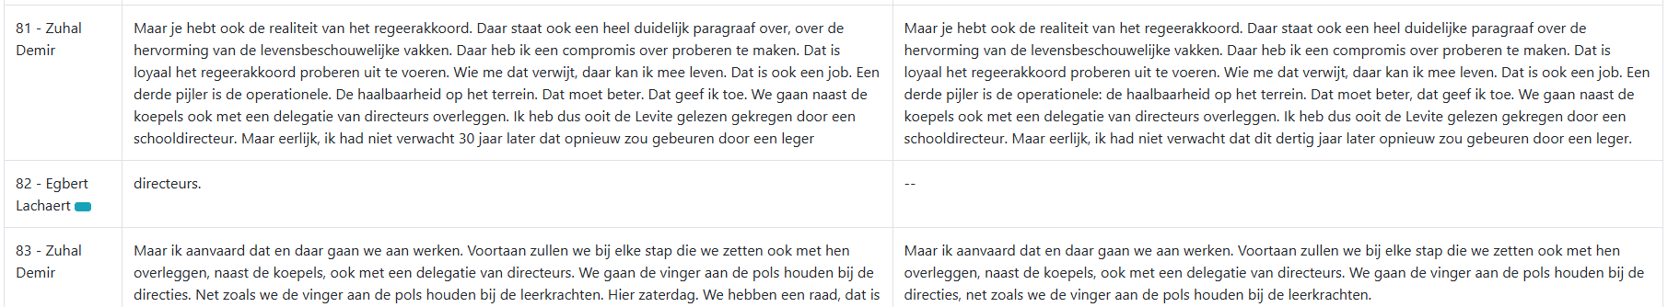

A small attribution error can become a reporting error
HUMAN INTERVENTION
Misrecognition does not stay local; it propagates through interpretation and editing.
Wrong address
Wrong context
Wrong AI draft
1
A phrase is assigned to the previous or next speaker.
2
The model reads a fragment incorrectly.
3
The generated text omits, invents or reframes the utterance.
Omitted word changes meaning
Notes:
The word directeurs (principals) is attributed to the wrong speaker and subsequently omitted completely by ChatGPT. The text on the right now speaks of ‘an army’ instead of ‘an army of principals’.
The marked text on the right is invented and completely different from what was said and transcribed.
To address these errors, reporters have to step in. When confronted with speaker recognition gone wrong, without any blue buttons available, they tend to either not use the tool at all for the take in question, or turn to the tool’s transcription-only page, where they find what is being said in large chunks of text.

Slide 12
Generative AI improves transcriptions – not all the time
HUMAN INTERVENTION
The post-processing layer is helpful, but it inherits and sometimes amplifies source problems.
50%
of transcriptions
enhanced by 5–10%
30%
of transcriptions
enhanced by more than 10%
Notes:
We use generative AI to improve the Whisper transcription and apply various linguistic and editorial rules. On average 50% of transcriptions is enhanced by 5 to 10% using ChatGPT. Nearly 30% is enhanced by more than 10%.

Slide 13
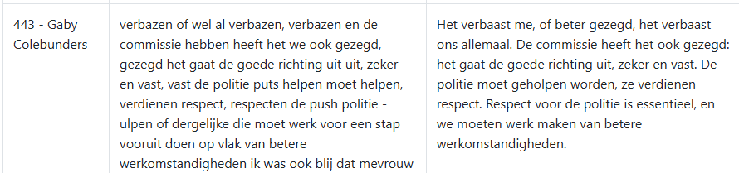
Generative AI improves transcriptions – not all the time
HUMAN INTERVENTION
The post-processing layer is helpful, but it inherits and sometimes amplifies source problems.
Clear improvement does not equal reliability.
When the source audio or transcription is flawed, ChatGPT may copy errors, misinterpret phrases, change correct wording or decline to process a fragment.
50%
of transcriptions
enhanced by 5–10%
30%
of transcriptions
enhanced by more than 10%
Source quality problem: misheard wording
Notes:
With poorly understandable speakers, for example, ChatGPT has a hard time righting the wrongs in the transcriptions. MP Gaby Colebunders is not talking about the police (politie) being in need of help, but about the cleaning aids (poetshulpen).

Slide 14
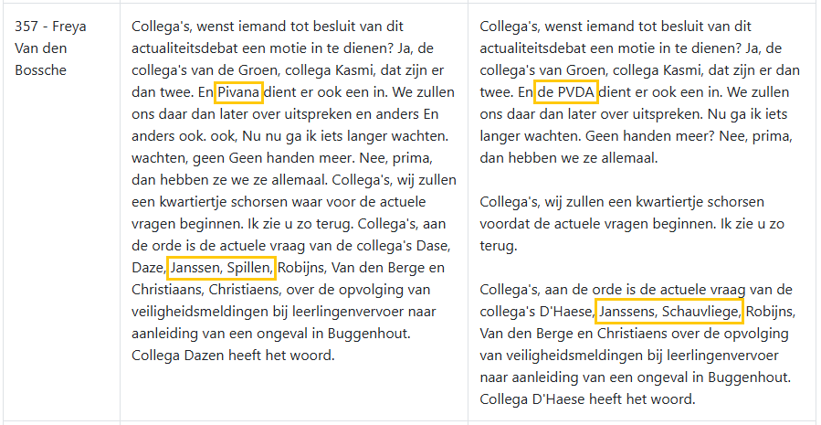
Generative AI improves transcriptions – not all the time
HUMAN INTERVENTION
The post-processing layer is helpful, but it inherits and sometimes amplifies source problems.
Proper names, abbreviations and local context remain high risk. AI can fix some recognition errors while inventing plausible but wrong alternatives.
50%
of transcriptions
enhanced by 5–10%
30%
of transcriptions
enhanced by more than 10%
Abbreviation corrected; names still risky
Notes:
While Pivana is surprisingly correctly turned into political party PVDA, the transcription turned proper names Janssens and Pillen into Janssen and Spillen, causing ChatGPT to convert Spillen to Schauvliege, the surname of another member of parliament also starting with an s. Mrs. Schauvliege was however not scheduled to ask a question.
The model knows the Flemish political parties, but it lacks the full situational schedule: who was present, who was expected to speak, and which local reference was intended.

Slide 15
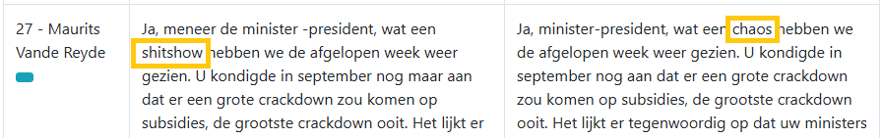
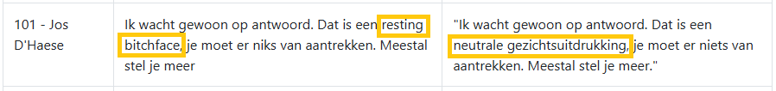
HUMAN INTERVENTION
Even a correct transcription can lose meaning in conversion
The generative layer may normalise wording, over-translate local usage or alter nuance.
1
Belgian Dutch vs. Dutch used in the Netherlands
Words or phrases that belong to standard Belgian Dutch can be replaced by standard Dutch from the Netherlands.
2
Slang & English phrases
Informal wording may be softened or translated away.
3
Filters & refusals
A fragment can be treated as inappropriate.
Notes:
Sometimes when Whisper correctly reflects the speaker’s words, ChatGPT still alters them. Often, yet not always, this has to do with differences between Belgian Dutch (Flemish) and the Dutch used in the Netherlands or with seemingly inappropriate English wording, which is then translated into Dutch.
This month, MP Chris Janssens said Minister-President Diependaele didn’t need a pregnancy om elkaar de duvel aan te doen. ChatGPT turned it into elkaar het leven zuur maken. Elkaar de duvel aandoen is Belgian Dutch.
During a plenary session in January of this year, MP Maurits Vande Reyde talks about a shitshow, which is unnecessarily converted into een chaos (chaos).
One month later, MP Jos D’Haese describes his own expression as a resting bitchface, which is, again unnecessarily, turned into een neutrale gezichtsuitdrukking (a neutral facial expression).
In other instances, the use of certain – correctly transcribed – words (such as verkrachting (rape)) activates ChatGPT’s profanity filter. The tool then simply refuses to convert the transcription.

Slide 16
Fluent AI text can make errors harder to hear
HUMAN INTERVENTION
Reporters may hear what is written, especially when the generated prose sounds polished.
The AI trust paradox
As models imitate human-like language more effectively, users can over-trust their outputs.
Notes:
Obviously, many of the mentioned types of AI errors are easily caught and corrected by the reporters Yet, although a lot of mistakes seem easily detectable, appearances deceive. Reporters are influenced by what the already generated text presents them with. While listening and following the processed text, it is easy to hear what is written and so miss an ASR or ChatGPT error. Moreover, since advanced AI models have become so effective at imitating human-like language, users tend to trust them too easily, which amplifies the risk of users uncritically accepting their outputs. This phenomenon is known as the AI trust paradox.
Minister Jo Brouns addresses MP Mieke Schauvliege as Mrs. Schauvliege (mevrouw Schauvliege). ChatGPT, however, turned this into ‘minister Schauvliege’, twice, which was copied by the editor.
In the following passage MP Jeremie Vaneeckhout briefly explains why he has withheld his vote. It’s not because he doesn’t support the urgency of the proposal (niet omwille van het niet steunen van de spoed), but because he has a pairing agreement with another representative. The transcription, however, misses the second negation (niet). The ChatGPT text subsequently also doesn’t mention it, which changes the meaning of the utterance. The editor copied the mistake.
When presented with a fluent AI generated representation of what was being said, reporters also tend to miss spoken language blunders more often.
The examples were corrected by the editors. The risk is that similar errors may pass when the draft sounds fluent and the reporter is under time pressure.

Slide 17
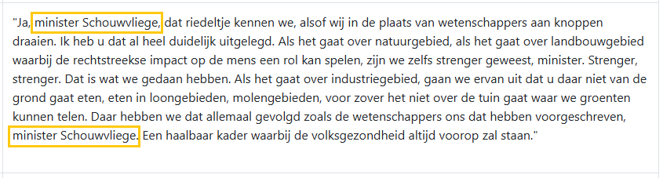
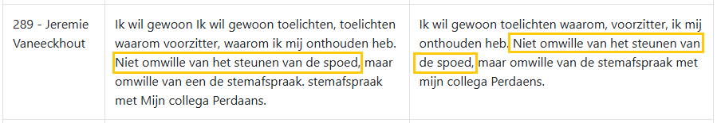
Fluent AI text can make errors harder to hear
HUMAN INTERVENTION
Reporters may hear what is written, especially when the generated prose sounds polished.
The AI trust paradox
As models imitate human-like language more effectively, users can over-trust their outputs.
Role title copied incorrectly
A missing negation changes meaning
Notes:
Obviously, many of the mentioned types of AI errors are easily caught and corrected by the reporters Yet, although a lot of mistakes seem easily detectable, appearances deceive. Reporters are influenced by what the already generated text presents them with. This also happens when they use the prepared questions and answers assistants and cabinet employees provide us with. While listening and following the processed text, it is easy to hear what is written and so miss an ASR or ChatGPT error. Moreover, since advanced AI models have become so effective at imitating human-like language, users tend to trust them too easily, which amplifies the risk of users uncritically accepting their outputs. This phenomenon is known as the AI trust paradox.
Minister Jo Brouns addresses MP Mieke Schauvliege as Mrs. Schauvliege (mevrouw Schauvliege). ChatGPT, however, turned this into ‘minister Schauvliege’, twice, which was copied by the reporter.
In the following passage MP Jeremie Vaneeckhout briefly explains why he has withheld his vote. It’s not because he doesn’t support the urgency of the proposal (niet omwille van het niet steunen van de spoed), but because he has a pairing agreement with another representative. The transcription, however, misses the second negation (niet). The ChatGPT text subsequently also doesn’t mention it, which changes the meaning of the utterance. The reporter copied the mistake.
When presented with a fluent AI generated representation of what was being said, reporters also tend to miss spoken language blunders more often.
The examples were corrected by the editors. The risk is that similar errors may pass when the draft sounds fluent and the reporter is under time pressure.

Slide 18
Be all ears: the central quality-control habit
HUMAN INTERVENTION
Human intervention is not a fall-back; it is the operating model for trustworthy AI-supported reporting.
Listen beyond the draft
1
Audio first
2
Context second
3
Draft third
4
Revision always
Notes:
Reporters must resist reading the AI draft as the truth. They need to listen actively and treat the generated text as a hypothesis.
Confirm the speaker’s actual words, meaning, timing and tone.
Check names, titles and references.
Use ChatGPT wording only where it matches the source.
Attentively revise before finishing.

Slide 19
AI can draft the report.
Humans must guarantee the record.
CONCLUSION
1
The promise is real – but the work will change
2
Human judgement is indispensable
Notes:
Although the integration of AI is helping the editorial services at the Flemish Parliament a great deal, it also thoroughly changes the way parliamentary reporters and editors work.
As the elimination of full manual transcription is perceived as a major physical relief, reporters are turned into AI generated texts editors.
We wish to extensively guide and tutor reporters in taking up their new role. This research seeks to raise awareness on AI integration pitfalls in an attempt to better equip them in executing that much needed human-driven quality control.
Official parliamentary reporting is too consequential to treat AI as an autonomous reporter. Human judgement remains the final safeguard for accuracy, context and public trust.

