Slide 1
Crafting Craftsmanship
Selecting and Training Parliamentary Reporters in the Netherlands
Laura van den Boogaard and Erik PJ Vrinds
House of Representatives of the Netherlands

Slide 2
Becoming a parliamentary reporter in the Netherlands
Selecting the very best
Training to perfection
Challenges
Notes:
Should you have an excellent command of the dutch language, a thorough understanding of political-administrative relations, have experience in the field of reporting and editing, an interest in politics we might be looking for you. As per september we are again looking for a number of court reporters. We have been very fortunate that so far 150-200 applicants have responded to every one of our vacancies. This luxury comes for us with the responsability of choosing only the very best candidates especially since they will be enroll in a year long internal training programme – which Laura will go into in a bit.

Slide 3
We are looking for you!
Excellent command of the Dutch language
Thorough understanding of political-administrative relations
Experience in the field of reporting and editing
Interested in politics
Notes:
Should you have an excellent command of the dutch language, a thorough understanding of political-administrative relations, have experience in the field of reporting and editing, an interest in politics we might be looking for you. As per september we are again looking for a number of court reporters. We have been very fortunate that so far 150-200 applicants have responded to every one of our vacancies. This luxury comes for us with the responsability of choosing only the very best candidates especially since they will be enroll in a year long internal training programme – which Laura will go into in a bit.

Slide 4
Are we looking for you?
The profession of parliamentary reporter does not exist anywhere else in the labour market
Do the applicants have a correct understanding of the profession?
Can we presume the chosen candidate accomplishes the successful completion of the internal training programme?
Notes:
When trying to select the best candidates from amongst the many applicants we have a difficult task. In the Netherlands the profession of court reporter only exists at our national parliament and is unknown to the labour market nor is there the chance to study for the position at a university. This leads to candidates applying for vacancies which they have no experience in as yet and seen from our perspective the need to offer the candidates a thorough training and education to be able to function in these highly qualified positions.

Slide 5
A selection that works both ways
Selection by letter
Assessment
Job interview
Notes:
When selecting the best candidates from the 150-200 applications we start with a screening of the application letters. Obviously qualifications are important but so are the visible language skills and if the applicant shows a correct description of the profession. After this first selection we invite approximately 40 candidates to take part in an assessment under the supervision of experienced court reporters. Not only has this assessment proven to be a clear indicator of the ability of the applicatant to finish the internal training programme but it also enables the participants to have a more complete picture of the job. This completer image sometimes make candidates re-think their application. After the assessment approximately 12 applicants are invited for for a job interview.

Slide 6
The realistic and relevant assessment
Knowledge test (political and general knowledge)
Language test
Reporting assessment

Slide 7
Example: Political knowledge
Name all Deputy Prime Ministers in this cabinet
Describe article 23 of the constitution
Name all parliamentary groups
Notes:
Political knowledge is one of the knowledge based tests taken by our applicants. These are some examples of questions ask.

Slide 8

Hooray, you got the job! What's next?

Slide 9

Intensive training!

Slide 10

Learning by doing
Contribute to the official edited verbatim report from week 1
Motivating to work on "the real thing"
Requires careful supervision

Slide 11

1:1 training
Two tutors
Continuous feedback loop
Resources: style guide, companion, glossary, search engines
Building up the workload: from 2 to 5 minutes (+ 30 seconds)
Goal: 5 minutes of spoken word translated into an edited verbatim report that meets the standards within 50 minutes

Slide 12

House of Representatives Academy
Brief overview of:
  Constitutional law
  The Rules of Procedure
  The work of committees
  The legislative process
  The national budget cycle

Slide 13

Evaluation
Every 3 to 4 months
Progress report (tutors)
Self-evaluation form
  Responsible for one's own learning process
  Identify development needs and opportunities

Slide 14

Self-evaluation
What have you learned?
What feedback have you received?
What did you do with this feedback?
What is your learning goal for the next period?
What (or who) do you need to achieve this goal?

Slide 15

Progress meeting
Reporter in training, tutors + line manager
Decision on continuation training
New tutors

Slide 16

Final stage of training programme
Junior parliamentary reporter (1 to 2 months)
Work independently
Colleagues proofread plenary work

Slide 17


Appointed as a parliamentary reporter

Slide 18
Challenges ahead
General shortage on the labour market?
How will the profession of parliamentary reporter evolve?
A lifelong job for younger professionals?
Notes:
It is to be expected that in a competitve labourmarket where professionals are in short supply our organisation will at some point experience the shortages already known in others fields of expertise. What will be the impact of for example AI and technological developments on the profession of court reporter? Will new products offered by our department have an impact there too? Last year we said goodbye to two collegues who had been working with us for over forty years. Is such a long carreer at one employer to be expected from younger professionals? Does this impact the possibility to offer a nearly one-year-long training programme?

Slide 19
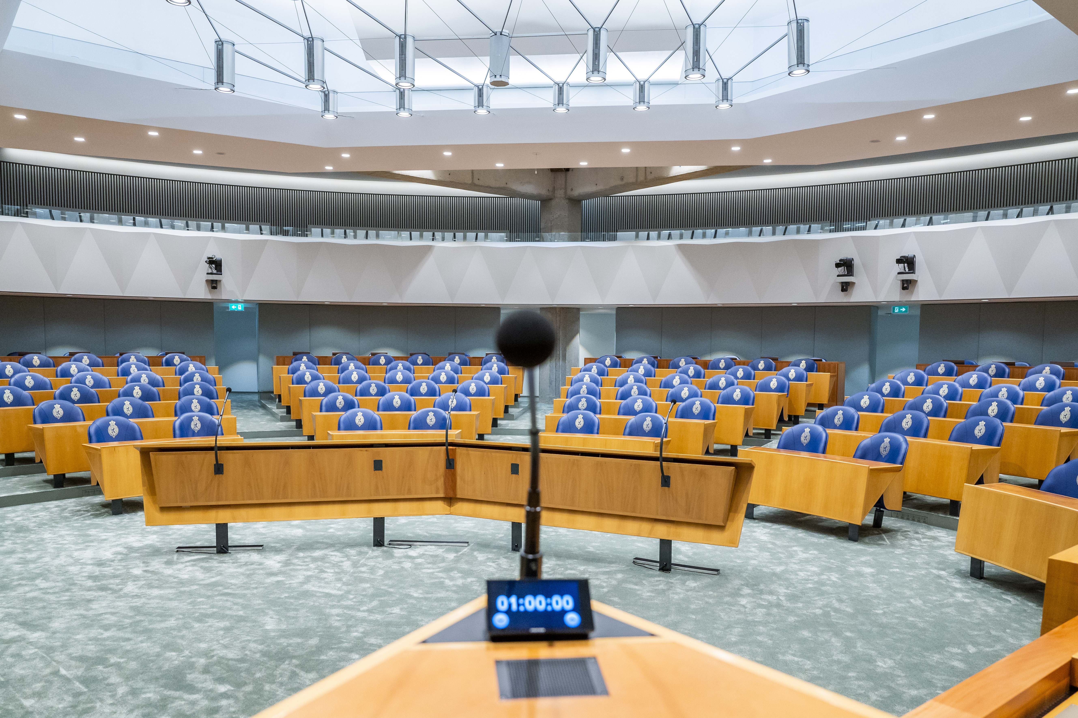
Thank you!
l.vdboogaard@tweedekamer.nl
e.vrinds@tweedekamer.nl

