Slide 1

Training and Work of Judicial Stenographers – Practice in China
Professor Chen Yang
BEIJING COLLEGE OF POLITICS AND LAW
•July 28, 2026
Notes:
Good morning, distinguished judges and colleagues. It is my great honor to stand here today and share with you the practices and reflections on the training and work of judicial stenographers in China, especially in the context of the rapidly evolving AI era.

Slide 2


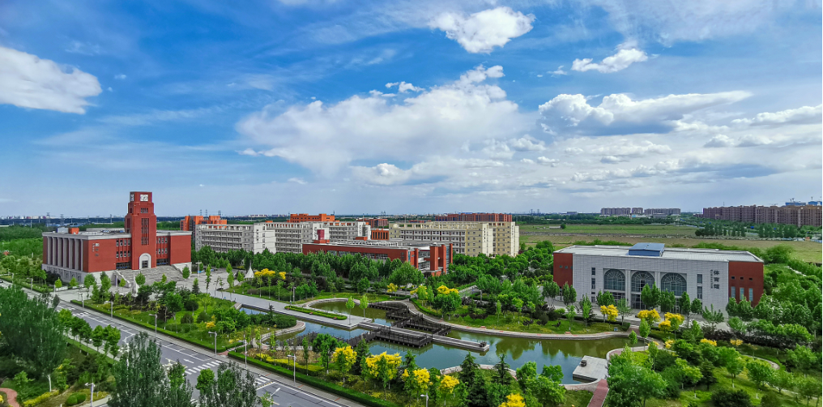
BEIJING COLLEGE OF POLITICS AND LAW
The college where I work is located in Beijing, the capital of China, and specializes in cultivating high-quality skilled professionals in areas such as legal support personnel, grassroots legal service personnel, mid-to-high-level security personnel, grassroots social management, and information technology services. It currently comprises six secondary school, including the School of Applied Law, with a total student population of 4,632 and 172 full-time faculty members.
Notes:
Third, a rigorous attitude and professionalism. Punctuality, discipline, and integrity are paramount. Handling sensitive information requires the strictest confidentiality. A clerk's conduct is a direct reflection of the judiciary's public image.

Slide 3
Executive Summary: Core Insights
01. Indispensable Judicial Pillar
02. "Three-in-One" Talent Development
03. AI-Driven Role Evolution
04. Human-Centric AI Collaboration
Notes:
In this presentation, I will highlight four core insights. First, the indispensable role of judicial clerks in China's overburdened judicial system. Second, our holistic "Three-in-One" model for cultivating these professionals. Third, how AI is driving a fundamental transformation in their role. And finally, our belief in a human-centric future where technology augments, but does not replace, human expertise.

Slide 4
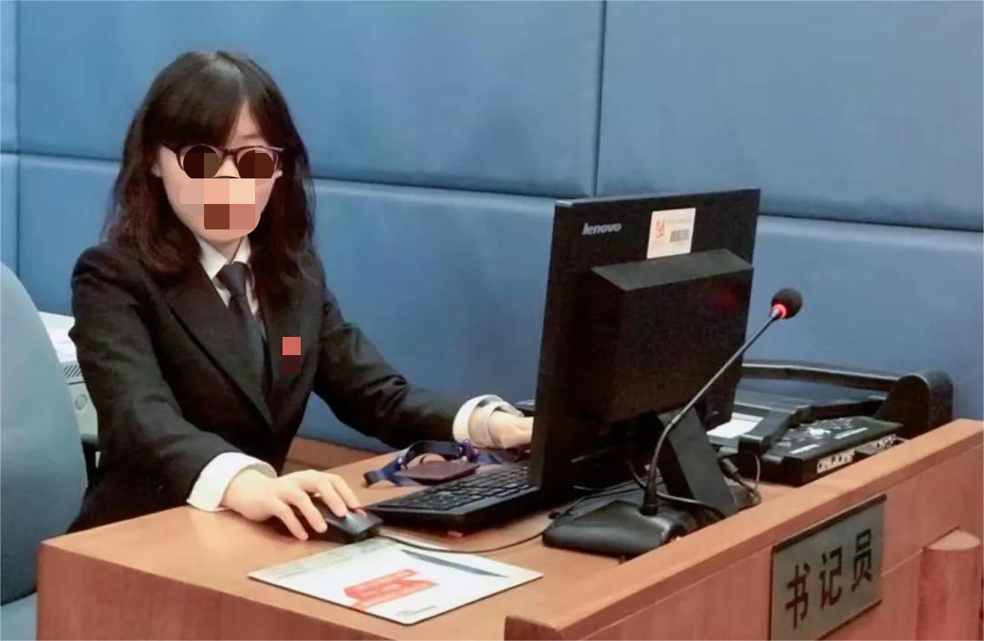
Part 1: The Silent Sentinels of Justice
Who are China's Judicial Stenographers?
Official Identity
Known formally as“Judicial Clerks (书记员)”or“Contracted Judicial Support Staff”, they are certified professionals with defined roles in the judicial administrative framework.
Indispensable Team Member
While not judges or prosecutors, they are the operational backbone of the court, managing case files, recording trials verbatim, and ensuring the adjudicative process runs efficiently.
A Judicial Clerk at work in a Chinese courtroom, meticulously recording proceedings to ensure an accurate and complete legal record.
The Verdict on Their Value
A senior judge once stated:“Without clerks, judges cannot hold court.”This powerful statement encapsulates their irreplaceable role in upholding judicial integrity.
Notes:
Let's begin by understanding who these professionals are. In China, they are called "Judicial Clerks." They are the professional support personnel, the silent sentinels, who ensure the wheels of justice keep turning. As one judge put it, their role is so critical that "without clerks, judges cannot hold court."

Slide 5

The Reality of "Case Overload": A Pressing Challenge
The Clerk’s Expansive Role in the Process
Courtroom Recording
Precisely capturing trial proceedings and testimonies for official records.
Case File Management
Organizing and maintaining comprehensive physical and digital case archives.
Document Verification
Reviewing legal documents for accuracy, consistency, and procedural compliance.
100,000+ Cases/Year
Per district court, revealing the acute national imbalance of "too many cases, too few judicial resources".
Pretrial Preparation
Conducting necessary investigations and serving legal summons and notices.
Notes:
The reality in China is a severe "case overload" crisis. Some district courts handle over 100,000 cases annually. This pressure has led to clerks taking on a multitude of roles far beyond traditional note-taking, from managing case files to assisting in document drafting, becoming true multi-taskers in the judicial process.

Slide 6
Part 2: The Chinese Model of Talent Cultivation
A Holistic Approach: The "Three-in-One" Educational Model
03.Immersive Internship
01. Targeted Recruitment
02.Comprehensive Skills Training
Notes:
To meet this challenge, we have developed a holistic approach to talent cultivation. Our "Three-in-One" model integrates targeted recruitment, integrated academic training, and intensive on-the-job internships. This ensures a seamless transition from classroom to courtroom.

Slide 7

Stage 1: Targeted Recruitment & Source Selection
Campus Recruitment Initiatives
Dual Assessment Selection Process
Strategic Role-Talent Alignment
On-site campus recruitment drives create direct access to top-tier academic talent, ensuring that judicial institutions connect with promising candidates at the earliest stage of their professional journey.
Notes:
The first stage is targeted recruitment. Top courts come directly to our campus. The selection process is rigorous, combining internships with exams and interviews, ensuring we find the right fit for the job from the very beginning.

Slide 8

Stage 2:Comprehensive Skills Training
Fundamental Legal Knowledge
Judicial Secretarial Practice
This stage merges rigorous legal theory with hands-on practical training, forming a "Three-in-One" educational model. It equips participants with the essential theoretical foundation and technical proficiency required for modern judicial administration.
Courtroom Shorthand Skills
Notes:
The second stage is integrated academic training. Our curriculum is built on a "Three-in-One" framework, combining legal knowledge, secretarial practice, and shorthand skills. Courses like courtroom shorthand and legal document training are designed to build a solid foundation.

Slide 9

Competency 1: Shorthand Skills - The Hard Threshold
01. Speed and Accuracy
High-speed typing is the foundational professional benchmark. Insufficient speed disrupts the flow of judicial proceedings, hinders the judge’s thought process, and risks incomplete records—making it an inviolable standard for entry.
02. Technological Proficiency
Mastery of specialized stenography software and rapid adaptability to new legal technologies are essential. Seamless integration with digital court systems ensures efficiency, data security, and compliance in modern judicial workflows.
Notes:
First, shorthand skills. Speed and accuracy are the absolute minimum requirement. A clerk who cannot keep up disrupts the entire trial. Equally important is proficiency with the latest stenography software and technologies.

Slide 10
Competency 2: Procedural Law Knowledge - The Foundation
01. Workhorse of Procedure
02. Understanding the "Why"
A clerk’s daily duties—serving legal documents, scheduling hearings, filing cases, and conducting pretrial investigations—all depend on a robust understanding of Civil, Criminal, and Administrative Procedure Laws. This foundational knowledge ensures every step is executed with precision, maintaining the integrity of the judicial process.
True proficiency lies in knowing not justhowto perform a task, butwhyit matters. This deeper comprehension ensures strict compliance with legal safeguards, protects the rights of all parties involved, and prevents procedural errors that could jeopardize case outcomes or fairness.
Notes:
Second, procedural law knowledge. Clerks are the workhorses of legal procedure. Every task they perform, from serving documents to filing cases, requires a deep understanding of civil, criminal, and administrative procedure laws. They must know not just the 'how', but the 'why'.

Slide 11

Competency 3: Rigorous Attitude & Professionalism - The Discipline
Core Traits: Unwavering Standards
Confidentiality: Protecting Institutional Trust
Public Image: The Face of Justice
Notes:
Third, a rigorous attitude and professionalism. Punctuality, discipline, and integrity are paramount. Handling sensitive information requires the strictest confidentiality. A clerk's conduct is a direct reflection of the judiciary's public image.

Slide 12
Competency 4: Professional Ethics & Identity - The Compass
01. Role Acceptance
02. Upholding Justice
Students must fully grasp and embrace the clerk’s pivotal role, which involves respectful engagement with all parties involved and the efficient management of substantial routine tasks. This understanding forms the basis of their professional identity and operational effectiveness.
Clerks serve as the guardians of judicial ethics, bound by the unwavering principles of fairness, impartiality, and integrity. Their conduct must reflect the highest moral standards, ensuring the trustworthiness and legitimacy of the legal process for all who seek justice.
Notes:
Finally, professional ethics and identity. This is the compass that guides everything a clerk does. They must accept their role and uphold the highest standards of fairness, impartiality, and integrity, acting as guardians of judicial ethics.

Slide 13
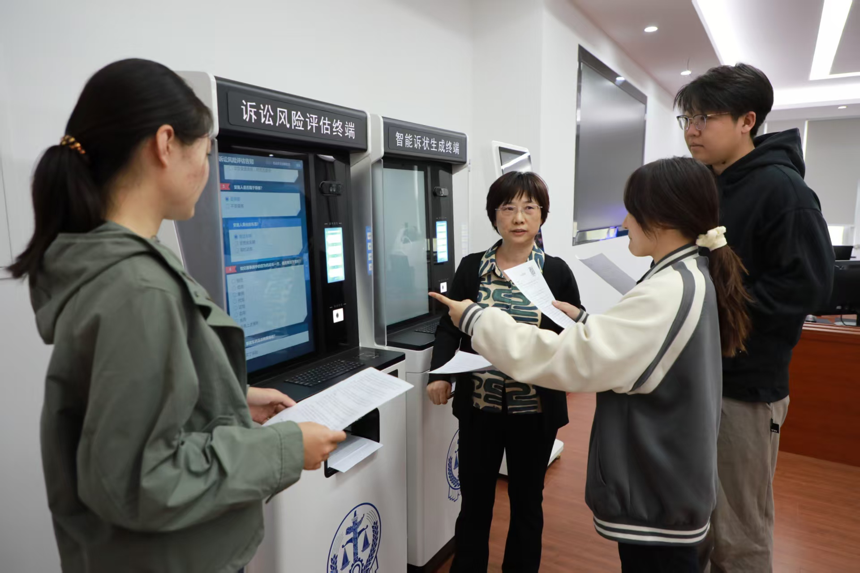
Stage 3: Intensive On-the-Job Internship
Immersive Early-Stage Placement
Beginning as early as the sophomore year, students are embedded in court environments for multi-month internships. This deep, hands-on immersion builds practical instincts long before graduation.
Seamless Transition to Employment
“By my official start, I had 8-9 months of on-the-job experience.” — Graduate. This eliminates the typical learning curve, enabling an immediate, confident shift to full-time legal roles.
Bridging Theory and Practice
Translates classroom knowledge into actionable legal skills. This critical bridge drastically reduces employer onboarding time, ensuring new recruits contribute effectively from day one.
Notes:
The third and final stage is intensive on-the-job internship. Starting as early as their sophomore year, students gain invaluable real-world experience. As one graduate put it, this extensive internship made their transition to a full-time role completely seamless, bridging the gap between theory and practice.

Slide 14
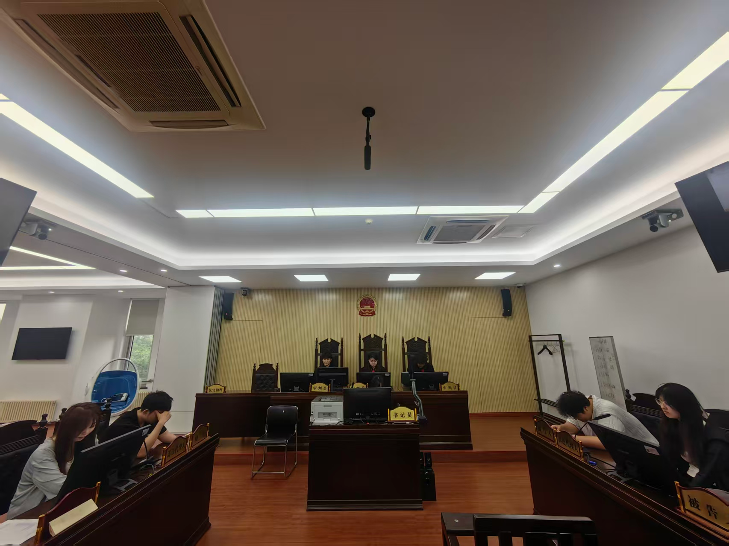
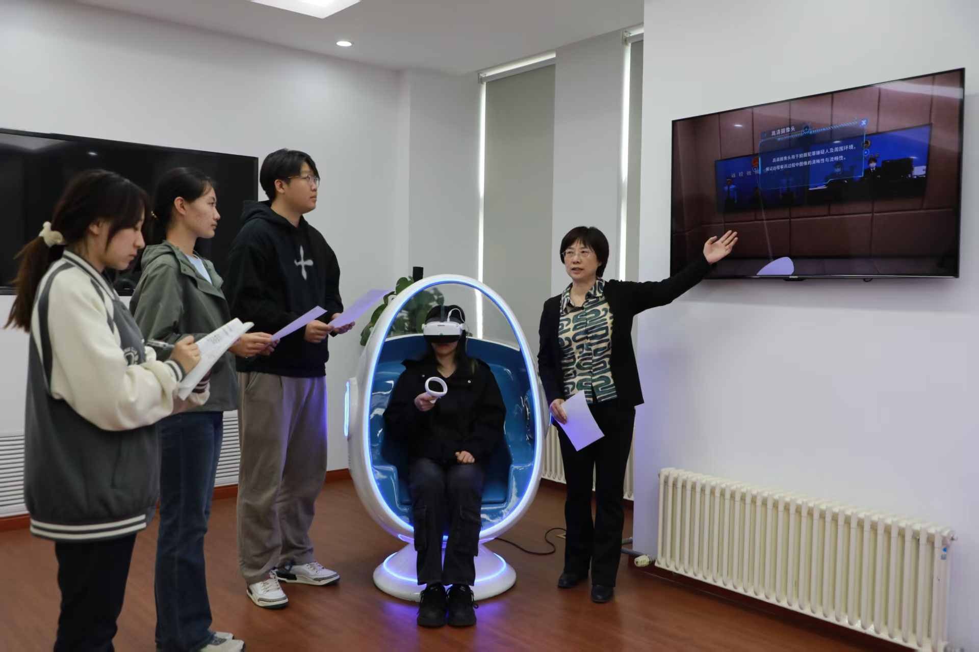
Technological Augmentation: Virtual Simulation Training
Innovative Training Tools
We’ve integrated the"People's Court Clerk Virtual Simulation Training System", a cutting-edge digital platform that transforms how we prepare legal professionals.
Overcoming Traditional Limits
This interactive environment transcends physical constraints, providing risk-free, hands-on practice without the limitations of accessing physical courtrooms.
"Bridging theory and practice through realistic digital replication, empowering the next generation of judicial clerks with practical, tech-driven experience."
Notes:
To further enhance training, we've embraced technology. Our "People's Court Clerk Virtual Simulation Training System" digitally recreates the entire case workflow. This immersive tool breaks down barriers, allowing students to practice in a realistic, risk-free environment, thus overcoming the limitations of traditional training methods.

Slide 15

Part 3: Embracing the Future: The AI Disruption
The Changing Landscape
AI and Computer-Assisted Transcription (CAT) tools are redefining the profession by automating repetitive tasks, enhancing accuracy, and accelerating turnaround times. This shift demands a new set of skills beyond traditional typing speed.
Our Forward-Thinking Philosophy
We view AI as an ally, not a replacement. Our training model is evolving to integrate AI proficiency, critical listening, and advanced editing skills, ensuring our graduates are equipped to leverage these technologies for higher-value, more creative roles.
“Adapt, don’t just adopt—thrive in the new era of intelligent transcription.”
Notes:
Now, let's look to the future. AI is disrupting every industry, and ours is no exception. But we see this not as a threat, but as an opportunity. We are proactively transforming our training model to ensure our graduates are ready for the AI era.

Slide 16
Conclusion - The Enduring Human Element
A Silent & Resilient Force
Tech & Talent Synergy
The Ultimate Guardian
Judicial stenographers are a quiet yet unyielding pillar in China’s journey toward the rule of law, leaving an indelible mark on the fair adjudication of every case.
In the AI era, we double down on investing in human capital. Technology is a tool to enhance, not replace, the irreplaceable nuance and judgment of skilled professionals.
Justice is safeguarded by people withconviction, competence, and unwavering responsibility—qualities that remain the heart of impartial justice.
“The future of justice lies not in machines alone, but in the hands of those who wield both skill and integrity.”
Notes:
In conclusion, judicial stenographers are a silent but resilient force in China's legal system. As we embrace technology, our commitment to investing in human talent grows stronger. Because ultimately, justice is not recorded by machines, but safeguarded by people with conviction, competence, and responsibility.

Slide 17

Thank You
Notes:
Thank you for your attention. I look forward to your questions and a fruitful discussion.

