Slide 1
Improving Dutch ASR transcripts through rule-based post-processing
Audio
Providing a workable draft for parliamentary reporting
↓
ASR transcript
Max van Winden
Parliamentary Reporting Office
House of Representatives of the Netherlands
↓
Post-processing
↓
Working draft
↓
Official report

Slide 2
Research question
  How can recurring problematic patterns in ASR output be described explicitly and addressed systematically?
The aim is not to produce an official report automatically.
The aim is to remove predictable friction.

Slide 3
Having text ≠ having usable text
  A raw ASR transcript may be impressive
  and still be tiring to edit.
Sources of friction
Recognition
Names, specialist terminology, word boundaries and capitalisation
Even perfect ASR would reproduce hesitations, repetitions and unfinished sentences.
Currently, ASR introduces errors that are not present in the audio.
How far can we improve the draft without correcting too much?
Spontaneous speech
Repetitions, restarts and grammatical irregularities
Editorial conventions
Numbers, hyphenation and fixed institutional forms

Slide 4
Boundaries
  Parliamentary reporting involves editorial decisions constrained by fidelity to the speaker.
 | Lower risk | Intermediate risk | Higher risk
Example | Known spellings, fixed compounds, capitalisation, number notation | Spoken openings, formulaic phrases, double connectors | Ambiguous repetitions, restarts requiring restructuring
Action | Correct automatically | Correct or flag | Reporter assesses

Slide 5
Rule-based approach
  A Python program applies the corrections to the raw transcript.
"minister president"
apply the agreed
compound form
"minister-president"
→
→
Why is this suitable for automation?
There is one stable preferred form.
The intended meaning remains unchanged.
The change can be logged, inspected and tested.
Python is flexible and well suited to systematic text processing, especially through regular expressions.

Slide 6
Correction sources
What sources can the system draw on?
Raw form | Correction | Category
het hoe en wat | het hoe en het wat | Fixed expression / grammatical completion
Bontebal | Bontenbal | Proper name correction
de ATR | het ATR | Article and grammatical gender
toezichting | toezegging | Recognition error
de Correspondent | De Correspondent | Proper-name capitalisation
... | ... | ...
Reference file | Size
Curated autocorrect list | 782 pairs
Preferred casing list | 11,913 forms
Reference dictionary | 478,909 entries

Slide 7
Example: correction of numbers
  Numbers show why simple conventions need context
Conventions
Numbers up to and including twenty are generally written in words.
In protected contexts, such as dates, they remain numerals.
Contextual rule: Write numbers up to and including twenty in words unless they occur before a month name or in another protected context.
Exceptions: percentages, currencies, measurements, ages, legal articles and fixed labels.
Input | Output
3 proposals | three proposals
21 questions | 21 questions
three March | 3 March

Slide 8
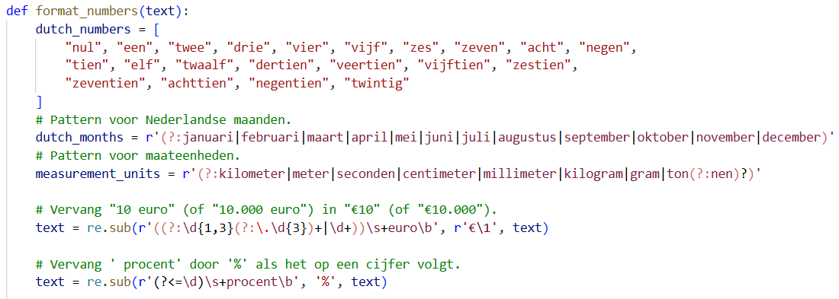
Encoding contextual rules
  Correction rules must be written with limits, exceptions and protected contexts.

Slide 9
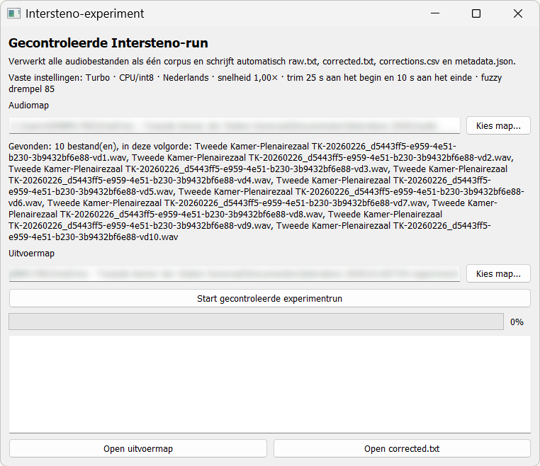
Workflow-based case study
47 minutes of audio from a politically sensitive parliamentary debate
Transcribed locally with the Turbo model in faster-whisper on an ordinary laptop
Post-processing added only a few seconds
281 automatic changes recorded
Raw and corrected output compared with the edited official report

Slide 10
Results
  Modest numerical gain, noticeable practical effect
Case-sensitive WER: 28.95% → 26.76% (≈ 7.6% relative reduction)
The official report is an edited reference, not a verbatim gold standard.
WER treats every word difference equally; reporters do not.
A wrong surname or institutional term can interrupt the workflow more than several small wording differences.

Slide 11
Useful and harmful corrections
Useful correction | Why it helps
Bontebal → Bontenbal | Restores a surname
bewindselieden → bewindslieden | Corrects a recognition error
een op een → een-op-een | Standardises a recurring form
Harmful correction | What it shows
vertrouwenscijfers → vertrouwenscrises | Similar spelling can change meaning
woon → WoON (WoonOnderzoek Nederland) | Ambiguous capitalisation
2033 → 2.033 | Number formatting rules need exceptions

Slide 12
Conclusion
  ASR post-processing: a layered division of labour
ASR produces the initial text. Explicit rules remove predictable surface noise and restore stable forms. A signalling layer may flag suspicious words or sentence patterns.
The reporter remains the central figure in the process.
By removing predictable friction from the draft, we hope to give reporters more time for the work that matters most: producing a reliable written record of the democratic process.

Slide 13

About the presenter
Max van Winden is a parliamentary reporter at the Parliamentary Reporting Office of the House of Representatives of the Netherlands.
He has a background in digital humanities and Dutch literary studies. As a member of a working group on speech-to-text technology, he explores how ASR and post-processing tools can be integrated into parliamentary reporting workflows to improve efficiency, consistency and quality.
Broader interest: digital text analysis and the role of accessible public information in democratic processes.
Contact information
max.vwinden@tweedekamer.nl

