Slide 1
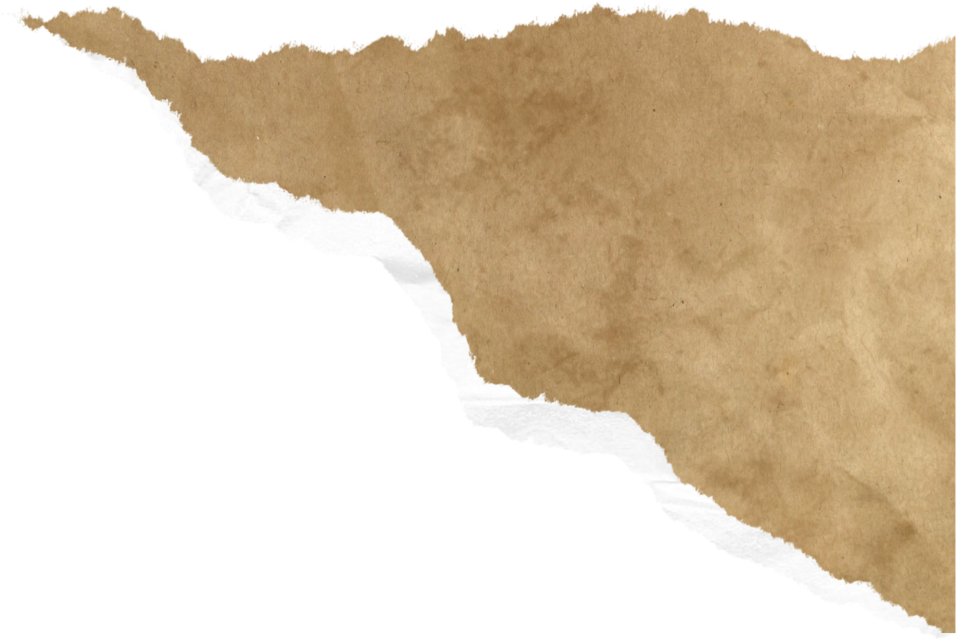



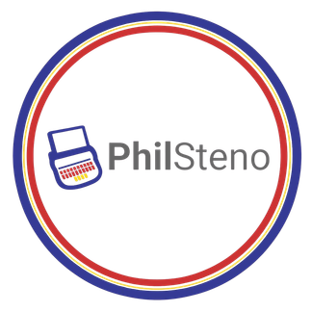



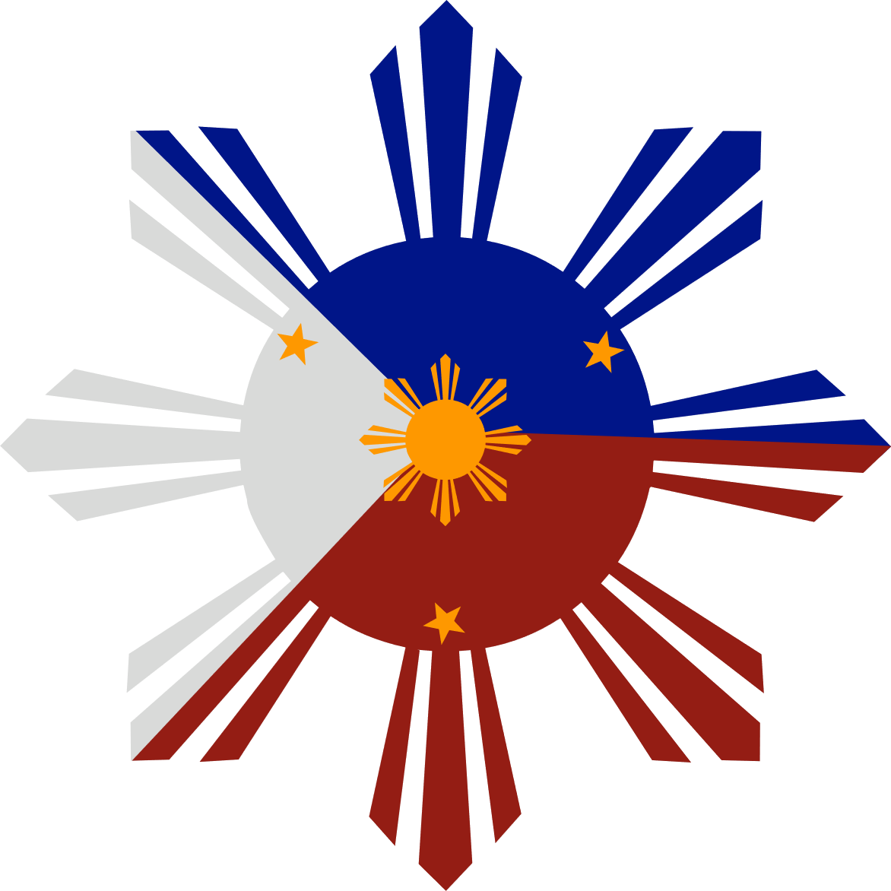





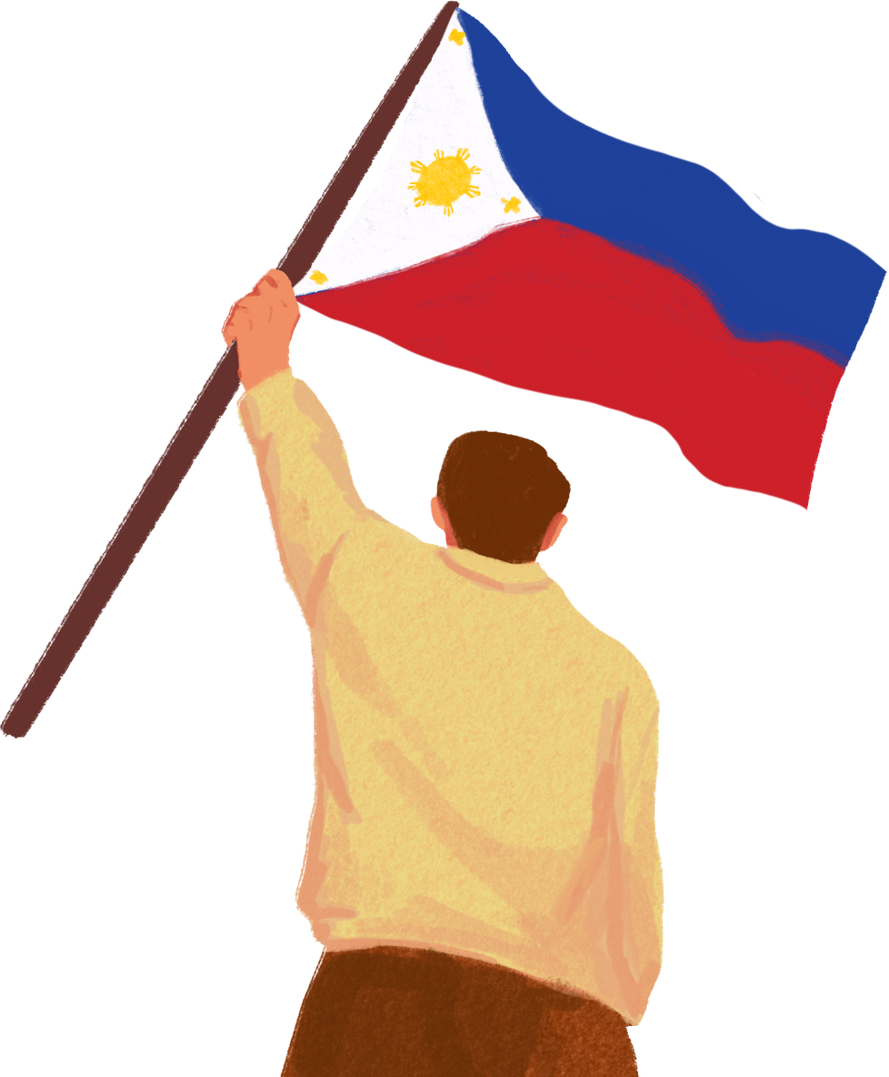










55th Intersteno Congress—Liverpool, United Kingdom
Reporting
Without
Barriers:
PHILIPPINE COURT REPORTING IN A GLOBAL CONTEXT
Mr. Christian Dabeh T. Clerigo
PhilSteno Ambassador
Notes:
Good morning, my name is Christian Dabeh Clerigo from the Philippines.
This presentation will discuss how the Philippines had a low barrier to assimilate writing systems and high barriers of challenges to converting the spoken word to transcript efficiently .
I will share thru my lived experience about Filipino stenography within national institutions and the global professional community.

Slide 2
Timeline: Philippine Writing Systems
Kawi
(9th–10th century)
Baybayin
(14th–16th century)
Latin/Castillan
(16th–19th century)
English
(20th century–present)
Filipino
(20th century–present)
An ancient Brahmic script of Javanese origin, evidenced in the Philippines through the Laguna Copperplate Inscription — the earliest known written document found in the country.
An indigenous Philippine syllabic script (abugida) used to record Tagalog and other local languages prior to Spanish colonization, reflecting a pre-existing tradition of written communication in the archipelago.
Introduced through Spanish colonization, the Latin alphabet and Castilian language became the dominant medium for religious, educational, and administrative discourse for over three centuries.
Introduced under American colonial administration and institutionalized through the public education system; remains an official language and primary medium of instruction in the Philippines today.
Declared the basis of the national language in 1937 and subsequently developed into Filipino, one of the two official languages of the Philippines under the 1987 Constitution.
Reporting Without Barriers: Philippine Court Reporting in a Global Context
Notes:
Let’s start with the timeline of Philippine writing systems. The first evidence of our writing system was from the Laguna copperplate inscription.
Kawi - In later centuries from around 12 to 17th , the Philippines used indigenous writing was called Baybayin.
Baybayin has 17 letters, or titik in Tagalog. There are 3 vowels, and 14 consonants’.
Would be used on leaves, bamboo, and stone.
Baybayin fell out of use in much of the Philippines under the Spaniards.
Under the Spaniards, learning the Latin alphabet also helped Filipinos to make socioeconomic progress, as they could rise to relatively prestigious positions such as clerks, scribes and secretaries.^{[20]}
Baybayin fell out of use in much of the Philippines under Spanish rule. Learning the Latin alphabet also helped Filipinos to make socioeconomic progress, as they could rise to relatively prestigious positions such as clerks, scribes and secretaries.^{[20]} In 1745, Sebastián de Totanés wrote in his Arte de la lengua tagala that "The Indian [Filipino] who knows how to read baybayin is now rare, and rarer still is one who knows how to write [it]. They now all read and write in our Castilian [i.e. Latin] letters."^{[4]} Between 1751 and 1754, Juan José Delgado wrote that "the [native] men devoted themselves to the use of our [Latin] writing".^{[65]} The ambiguity of vowels i/e and o/u, the lack of syllable-final consonants, and of letters for some Spanish sounds may also have contributed to the decline of baybayin.
https://en.wikipedia.org/wiki/Baybayin

Slide 3

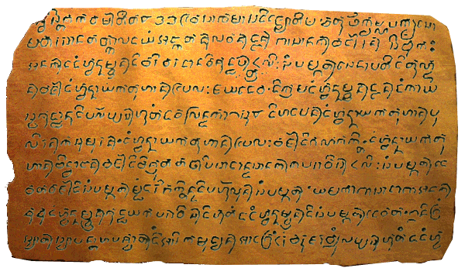
Laguna
Copper
Plate
Laguna
Copper
Plate
https://en.wikipedia.org/wiki/Laguna_Copperplate_Inscription#/media/File:Laguna_Copperplate_Inscription.gif
Notes:
The written word in the Philippines started before the Spaniards reached our shores in 1521.
In the Philippines we have evidence of a written document as far as the 9th century as there have also been evidence of cultural exchange in the southeast Asian region during this time extensively among the Philippines and its neighbors.
The Kawi script is an old writing system from Southeast Asia, used mainly from the 8th to the 16th century to write. It is a type of alphabet where each letter has a built-in vowel that maybe came from South India.
The Laguna Copper Plate which was found in the Philippines is the written word used to capture economic transactions as this Laguna copper plate in plain words was a receipt of an economic transaction.

Slide 4
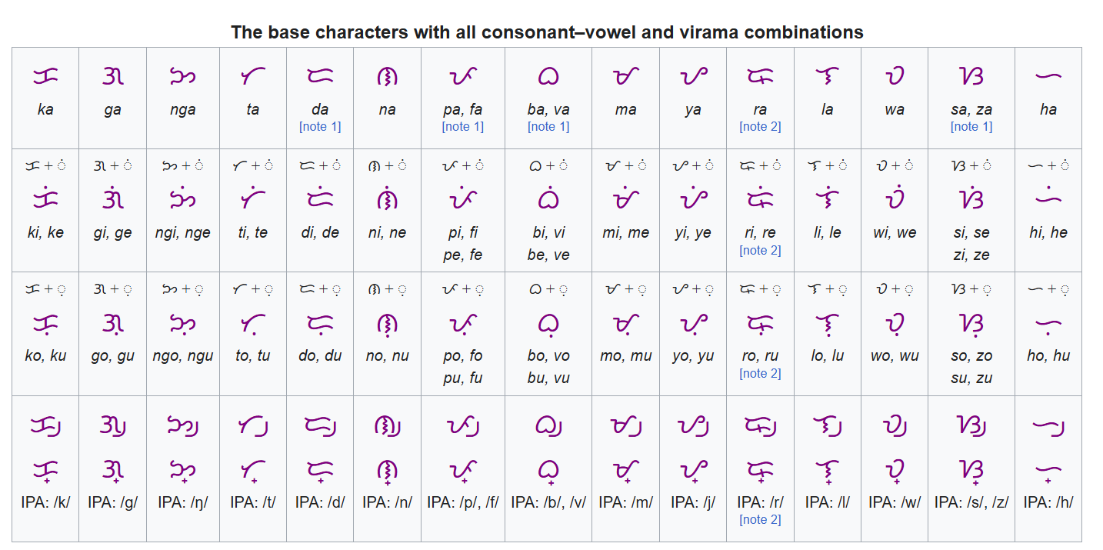
Baybayin

Slide 5
175+
2
1
Philippine dialects spoken across the archipelago
official languages of government — Filipino and English
language of the official court record — English, in nearly all proceedings
The gap: witnesses often testify in a regional dialect, are interpreted into English by the court interpreter, and are transcribed into English by the court stenographer — meaning the words pass through two different people's translations before they become the official written record.
Reporting Without Barriers: Philippine Court Reporting in a Global Context

Slide 6
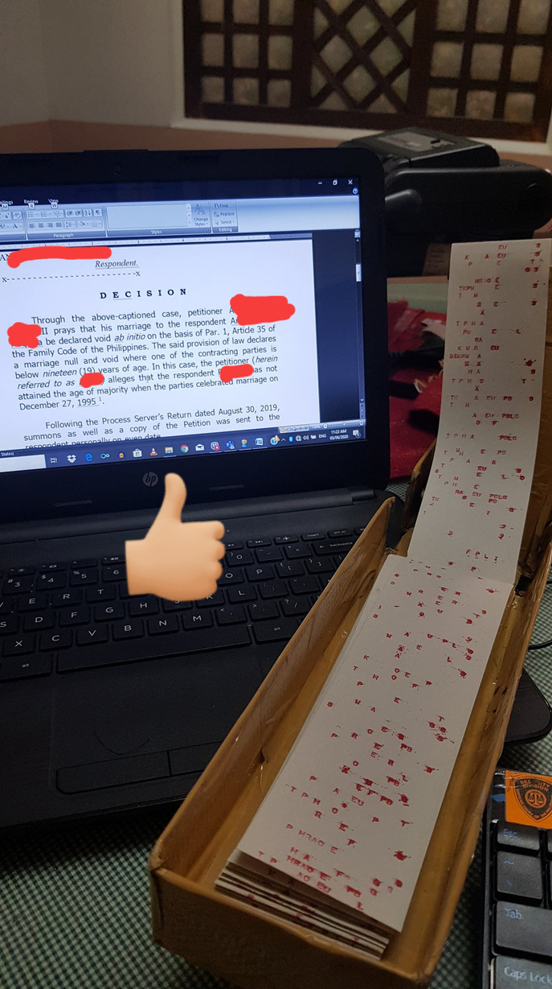

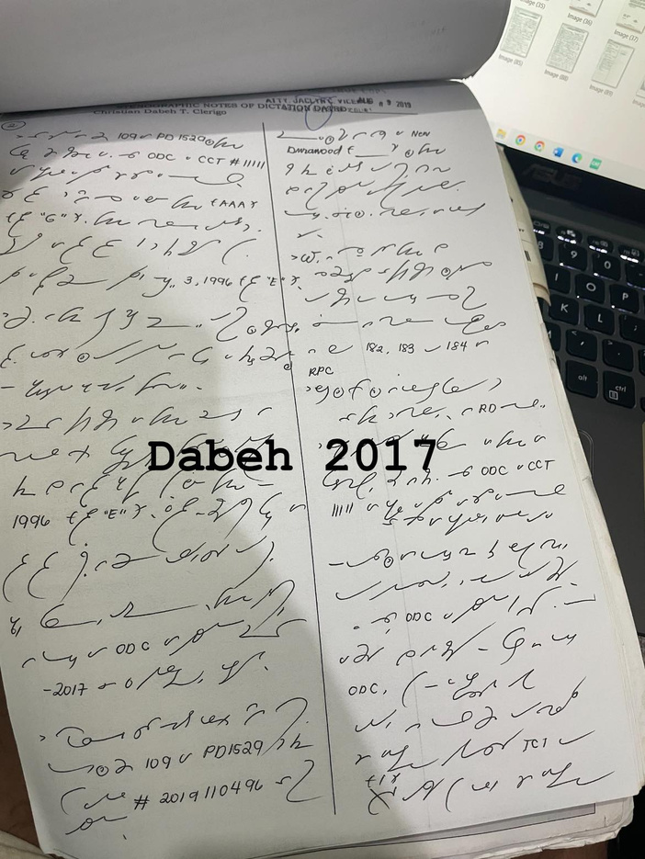
Stenography (as a profession)
  Court Reporter
(most common term)
  Realtime Reporter/Official Court Reporter
  CART Reporter
  Captioner
  Shorthand Writer
  Stenographer
  Parliamentary Reporter
Worldwide counter-parts
  Court Stenographer(s)
  Legislative Officers/Assistants
  Non-Court/Executive Stenographers
Philippines=
Stenographer(s)
Reporting Without Barriers: Philippine Court Reporting in a Global Context
Notes:
Our Terms for Stenographers in the Philippines are the following:

Slide 7
Technology & Innovation in the Courtroom
Gregg Shorthand and Takigrapiya
Historical and still widely practiced method using pen-and-paper phonetic symbols (such as takigrapiya in local adaptations). Highly dependent on manual typing and post-hearing transcription by individual stenographers.
Stenotype + CAT Software
Modern stenotype machines paired with Computer-Aided Transcription (CAT) software. Translates steno keystrokes into written text in real time, drastically cutting transcription turnarounds.
Digital Audio Recording
A backup method for courts with limited stenographer availability, providing a secure secondary file in case of equipment failure or unclear shorthand notes.
Videoconferencing & e-Court
Remote and hybrid hearings, accelerated by the pandemic
AI-Assisted Transcription (Pilot Stage)
Early trials explore automated speech-to-text as a support tool — promising for backlog relief, but not yet a substitute for a court stenographer.
Reporting Without Barriers: Philippine Court Reporting in a Global Context
Notes:
In the Philippines we use graphic and machine shorthand stenography.
Our professionals are called Stenographers unlike in other countries, they are referred to as Court reporter (read the others)
Stenotype machines are used in the 1980, 90’s and early 2000’s and then it is being revived again.
Most stenographers in the Philippines have digital recorders, an important tool used as a back up for their Stenographic notes. Now these recordings are being used to be uploaded to an AI-assisted transcription software to create a draft.
Pursuant to the principle of innovation, the Court introduced Speech-to-Text Engine, an artificial intelligence tool designed to transcribe recorded hearings and assist stenographers in preparing official transcripts.

Slide 8
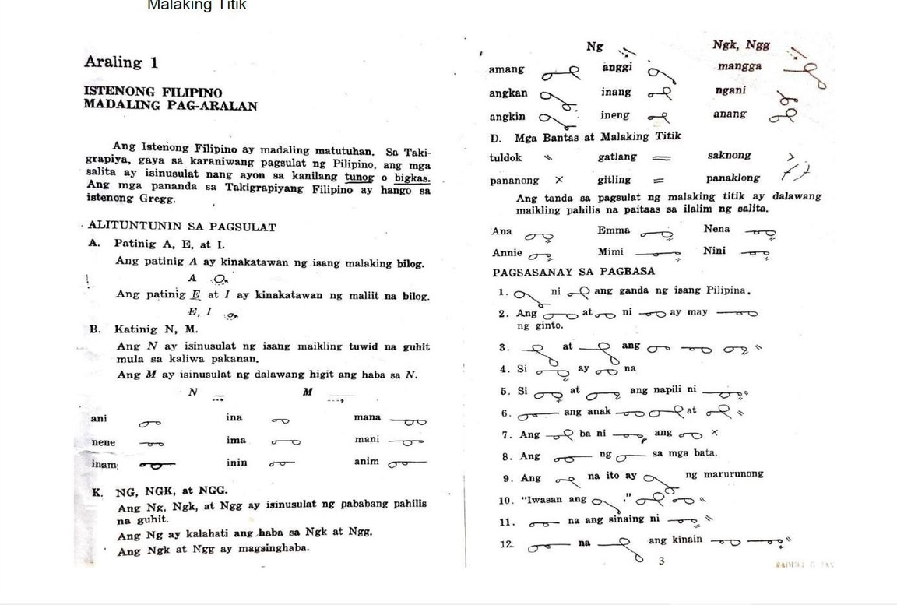
Takigrapiya (20th C)
https://en.wikipedia.org/wiki/Baybayin
Notes:
By the 1960s, a localized practice of writing based on Gregg called Takigrapiya was developed. The Philippines adopted the principles of Gregg with their local language-Filipinos.
At the moment, it is only done in the national Filipino language which is Tagalog Based and it is not used for the other dialects. Takigrapiya is used as the Court allowed taking of testimonies in the vernacular for under age witnesses and is also used for their notes.

Slide 9
THE PROFESSION TODAY
The People Behind the Record
7,000+
Court stenographers are, in the Chief Justice's own words to the profession, “true frontliners” of the justice system — their role runs deeper than transcription: without their work, cases do not move, and neither does justice.
court stenographers currently serving the Philippine judiciary nationwide

Slide 10
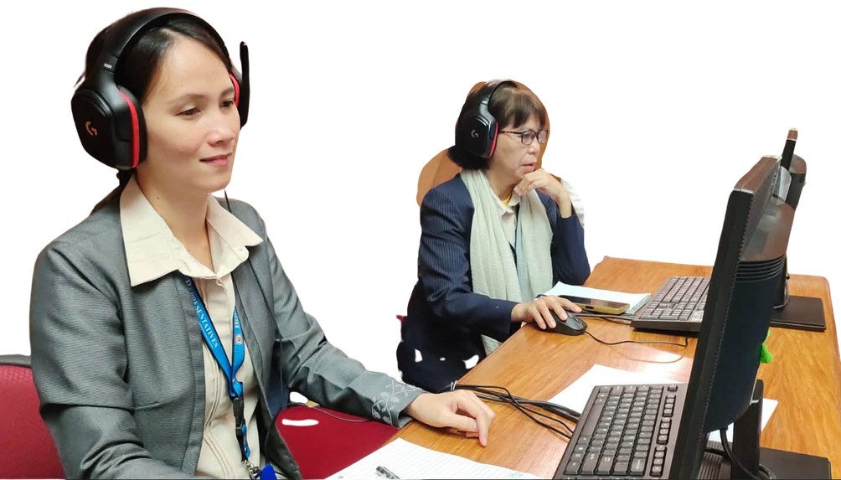
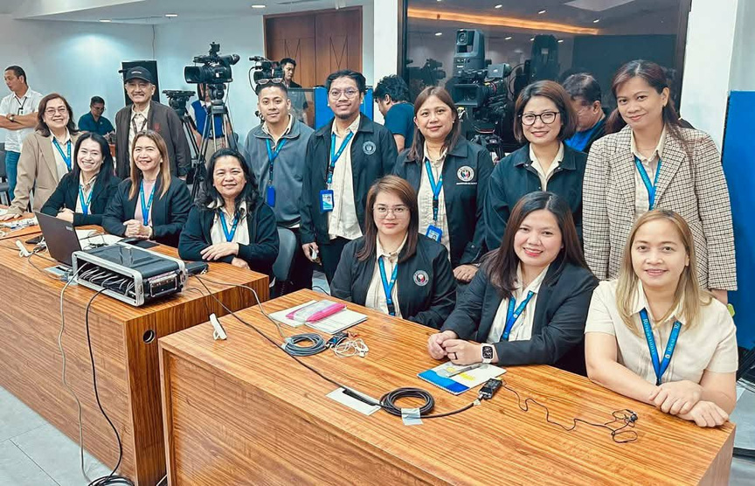
Stenography in the Philippines
Legislative Staff Officers
(House of Representatives)
  Congressional stenographers in the House of Representatives (Legislative Staff Officers) record all bills, passages, proceedings, and House matters.
Reporting Without Barriers: Philippine Court Reporting in a Global Context
Notes:
Located not only in the Courts but also in the

Slide 11
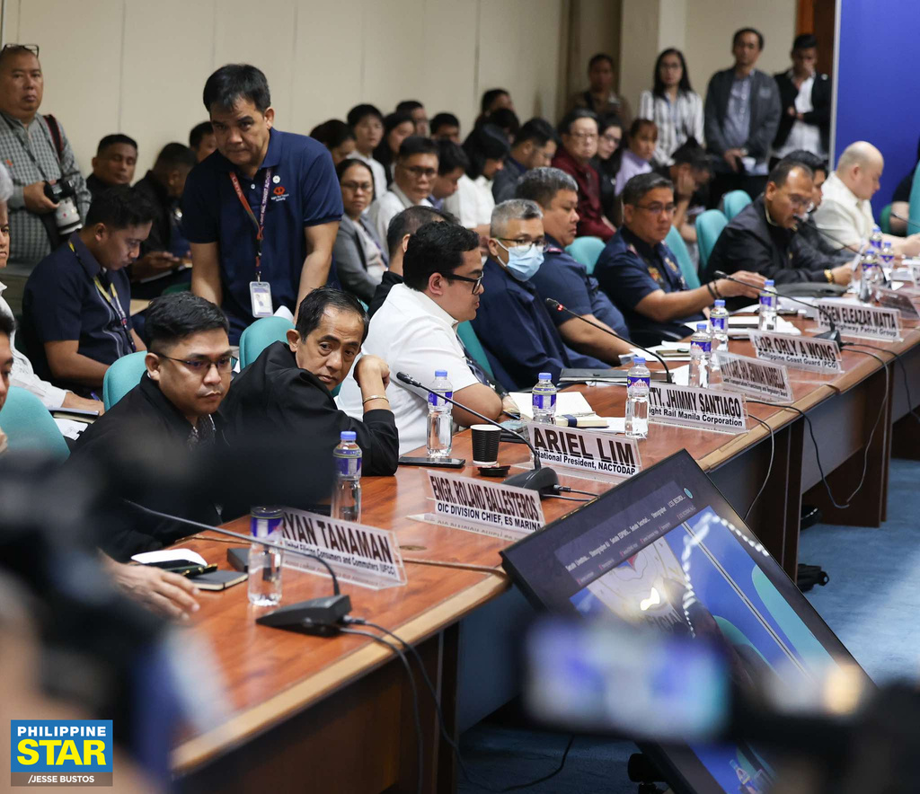
Stenography in the Philippines
Legislative Staff Officers (Senate)
Congressional stenographers in the Senate (Legislative Staff Officers) record all matters dealt in the Upper House and make accurate transcriptions of proceedings.
Photo Credits: Facebook: Philippine Star
Reporting Without Barriers: Philippine Court Reporting in a Global Context

Slide 12
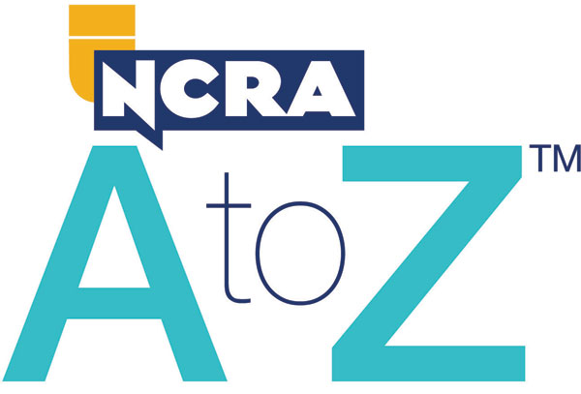

NCRA A to Z Program
Is a seven-week introduction to Steno Machine Shorthand
participants learn how to write the alphabet and numbers in steno.
This program does not follow any particular theory. Participants use loaner steno machines during sessions and outside practice.
Reporting Without Barriers: Philippine Court Reporting in a Global Context
Notes:
This was introduced in 2019 to start re-training of machine stenotyping with CAT Software.
It was adopted with permission from the National Court Reporters Association of the US.
It is a low impact way to introduce the career of Stenography in the steno writing within six sessions.

Slide 13
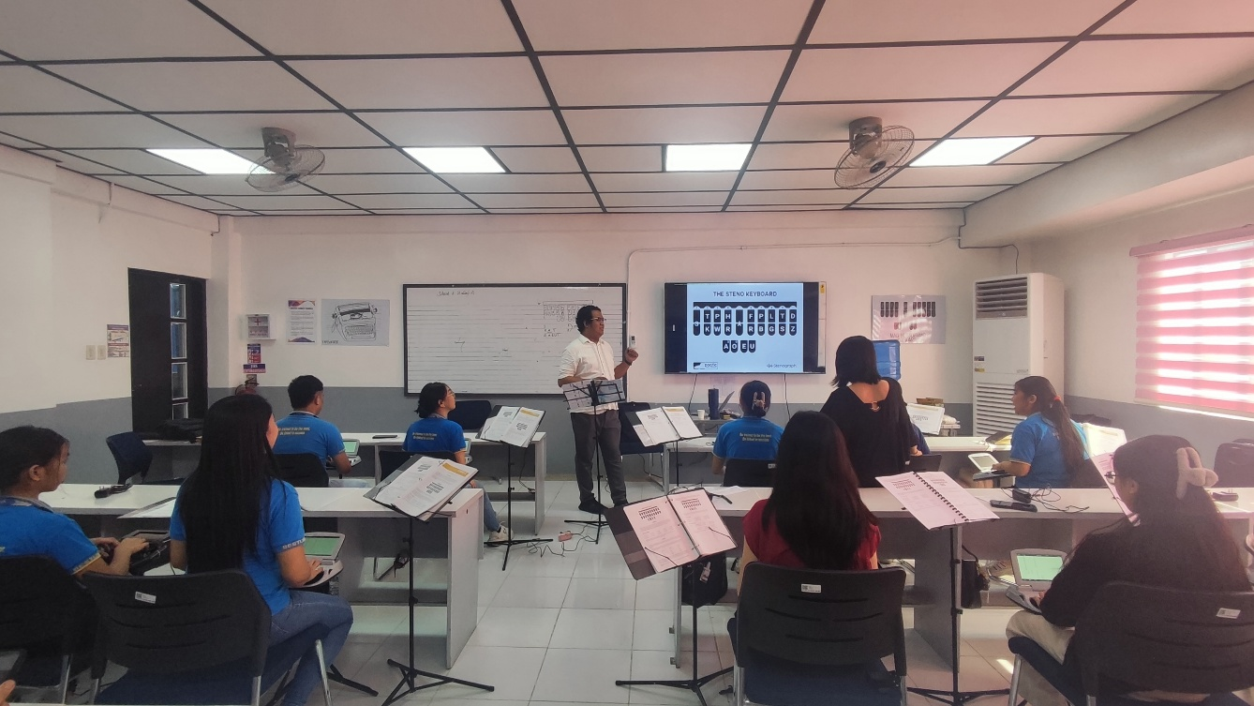
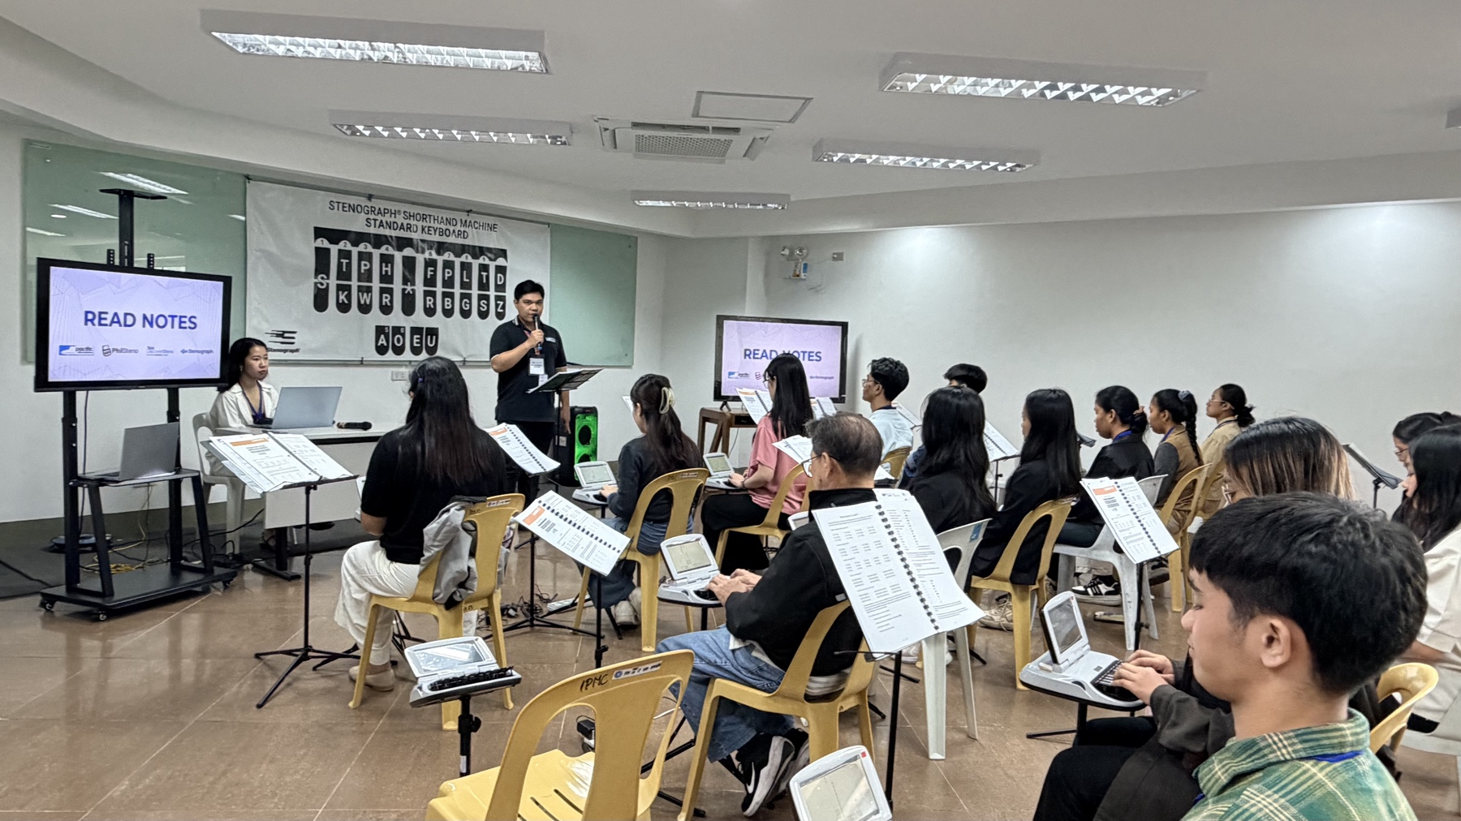
Impact of NCRA A to Z in the Philippines
Promotes Awareness
Introduces students and professionals to machine shorthand and modern court reporting.
Develops Future Talent
Inspires students to pursue careers in court reporting, captioning, and realtime transcription.
Supports Educational Institutions
Encourages schools to adopt modern stenography teaching methods and international best practices.
Reporting Without Barriers: Philippine Court Reporting in a Global Context
Notes:
We needed to uplift the profile of our stenographers and bring attention to them and so we’re going to different activities like :_____

Slide 14
THE CHALLENGE
Barriers to a Reliable Record
1
Language Diversity
2
Caseload & Backlogs
3
Geographic Dispersion
Testimony in a regional dialect, filtered through an interpreter, transcribed in English — three chances to lose precision.
Heavy dockets leave stenographers producing transcripts under time pressure across multiple simultaneous cases.
A nation of islands creates challenges in delivering training, technology, and opportunities to aspiring court reporters nationwide.
4
Uneven Technology Access
5
Training Pipeline
6
Access to Justice
CAT software and digital recording are common in urban courts but inconsistent in provincial and rural branches.
Formal shorthand and stenotype instruction has narrowed as fewer schools teach it, tightening the supply of new stenographers.
Litigants with disabilities, limited literacy, or no shared language with the court risk being underserved by the record itself.
7

Slide 15
A PATH FORWARD
Toward Reporting without Barriers
1
Standardize digital tools nationwide
Extend CAT software and digital audio backup to every circuit and municipal court, not only urban centers.
2
Rebuild the training pipeline
Partner with schools and Civil Service programs to restore formal stenography and CAT instruction.
3
Integrate court interpretation
Formalize interpreter protocols for the country's major regional languages alongside stenographic capture.
4
Benchmark against Intersteno
Adopt shared international speed, accuracy, and certification standards to raise and compare performance.
5
Expand accessible captioning
Pilot real-time captioning for litigants with hearing loss or limited literacy, starting in major urban courts.
REPORTING WITHOUT BARRIERS · INTERSTENO DIAMESIC CONFERENCE — SCIENTIFIC COMMITTEE
11
Notes:
We see that the path forward is to standardize tools nationwide

Slide 16
Maraming
Salamat!
Follow our Social Media Pages:
PhilSteno
StenoTalino.Ph
InterSteno Philippines

