Slide 1
How do we transcribe dialect speech in parliamentary recordings?
Tatsuya Kawahara
(Kyoto University, Japan)

Slide 2
Introduction
“Standard” speech is usually expected in parliamentary meetings.
But we occasionally observe dialect speech uttered by MPs.
Dialect is often used intentionally for showing regional identity and emphasis, or for rhetorical effect.
How do we cope with them?
Dialect is a variation of the “official” language.
Welsh is not a dialect of English.

Slide 3
Aspects of Dialect
Variation of Pronunciation (including prosody)
  /k/ → /g/ (ex.) “mukasi” → “mugasi”
Different Vocabulary
  “subway”, “underground”, or “tube”
Variation in Morphology
  “I ain’t”

Slide 4
Do MPs use dialect (intentionally)? Why?
Regional identity and emphasis
  To show connection to their constituents
  To add emotional emphasis or authenticity
Rhetorical effect
  To carry cultural connotations of warmth and humor
  To stand out in debate

Slide 5
How is dialect speech transcribed in the official meeting record?
Balance of accuracy (faithfulness) vs. readability (formality)
Variation of Pronunciation → (always) normalized
  “mugasi” → “mukasi”
Variation in Morphology → (usually) normalized → more accetable
  “I ain’t” → “I am not”, except for strongly intentional use
Variation in Vocabulary → ???

Slide 6
Keep or “Correct” dialect vocabulary?
Output of
some AI
Keep the dialect word as-is when
  The word is widely understood
  Use of the word is significant politically or culturally
  The speaker clearly intended it
  No standard equivalent exists
Replace the dialect word when
  The exact wording is not considered important
  The word might confuse readers from other regions
  A clean standard equivalent exists
Add explanation or annotation when neither 1 and 2 met
  The word is significant, but not widely understood
National Parliament, such as Japan and UK, prioritize nationwide readability, uniformity, and consistency.

Slide 7
Output of claude.ai
The handling of dialect vocabulary quietly reflects an institution's attitude toward linguistic diversity.
Consistently replacing dialect words with standard equivalents sends an implicit message about which language forms are considered legitimate in political life — and erases part of the historical and cultural record of how politicians actually spoke.
Now in UK Hansard,
The default is to retain the dialect word, not replace it: This is the key shift since the 2022 dialect group was formed. While older Hansard practice tended to push toward formal standard variants, the modern approach is to keep distinctive dialect vocabulary on the page rather than translating it into standard English.
The team explicitly builds glossaries for this: Rather than each reporter guessing, they share institutional knowledge.

Slide 8
Do you have a guideline for handling dialect?
Is it different between national and local parliaments?

Slide 9
Cases in Japanese Parliament (Diet)
Guideline
  Dialect words are transcribed in Hiragana (Phonetically)
    (ex.) こぜる、ようけ
  Ryukyu dialects (much different from mainland dialects) are transcribed in Katakana (Phonetic symbols used for foreign words)
    (ex.) ウチナーンチュ、エイサー
  Glossary is prepared and shared by reporters
Common practice (via interview)
  Can be normalized if it is regarded as a minor colloquialism and pronunciation variation of the standard word (when most phonemes are shared)
    (ex.) そないな → そのような、そったな → そういったような、あんた → あなた
Never change into a different word (even if it is not understandable by many people)

Slide 10
Cases in Regional/Local Assemblies
Local assemblies have more permissive or even actively inclusive policies toward dialects
  Representatives speak directly for local communities
  Dialect is part of regional identity
  The audience is more familiar with local speech
Some autonomous regions have strong dialect politics
  (ex.) Scotland, Catalonia, Corsica
Some regional guidelines are more detailed
  But mostly depend on the person in charge of records

Slide 11
Cases in Courts in Japan
Guideline
  Dialects are transcribed as they are uttered.
  Accented pronunciations are corrected.

Slide 12
Case Studies in Japanese:
Transcription of Dialects by Stenographers
National Parliament (Diet)
  Stenographers of the House of Representatives
Reporting company in Osaka
  Staffs working for meeting records of local assemblies
Asked how they transcribe dialect words and speech
  Demonstrative pronouns, nouns, verbs, greetings
  Meeting record of the national parliament and some local assembly

Slide 13
Case Studies in Japanese:
Transcription of Dialects by Stenographers
Pronunciation variations
  Normalized in lexicon
  (ex.) よがった (yogatta) → よかった (yokatta)
Morphological variations
  Corrected to formal style in national parliament, but NOT in local assemblies
  (ex.) しとる (shitoru) → しておる (shiteoru) / keep in local
  (ex.) そやね (soyane) → そうやね (souyane) / keep in local
Vocabulary (lexical entities)
  Kept as it is except for minor corrections in national parliament
  (ex.) あんた (aNta) → あなた (anata) / keep in local

Slide 14
On the other hand,
Usage of dialects has declined over past decades
National Parliament (Diet)
  Only a few, very senior MPs use dialects
Local Assemblies
  Dialects observed often >10 years ago
    Demonstration of locality
    Expression of emotions
  Hardly observed at present
    Everyone speaks the standard Japanese
  ← Effect of video streaming/recording??

Slide 15
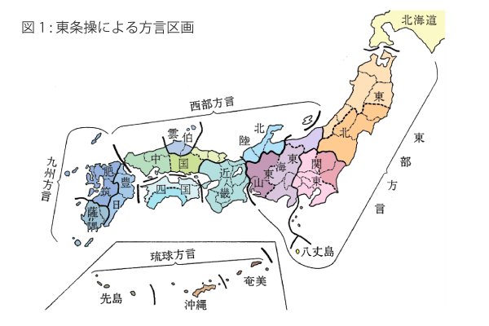
Automatic Recognition of Dialect Speech
Corpus of Japanese Dialects (COJADS)
  Cover all parts of Japan
  Conversations by elderly people
  Ainu and Ryukus are regarded as
  different languages
Automatic dialect identification (DID)
  Almost accurate (87% for four dialects)
Automatic speech recognition (ASR)
  Very challenging

Slide 16
Conclusions
Dialects are faithfully transcribed in Parliamentary records, except for accented pronunciation variations.
They are more acceptable than before and in local assemblies.
But dialects are not observed as before.
← Side effect of video streaming/recording (?)
CAUTION: Some automatic speech recognition (ASR) systems may automatically correct dialect words since they were trained with speech and captions of the video.

