Slide 1
The Effect of Computer-Aided Stenography in Korea
Yeonhwan Choi, Koreasteno
28 July 2026

Slide 2
Koreasteno
Korean Chord-Machine / Computerization of Stenography
Education
The first company that made Korean chord-machine for stenographers
It leads computerization of stenography of Korea
Offering TV Closed Caption
Over 10,000 users who can use Koreasteno’s keyboard
The first company that served TV closed caption in Korea since 1999

Slide 3
Koreasteno
Offering Live Caption to Streaming Video Service (Netflix)
International Exchange
In 2026, Koreasteno delivered live Korean captions to Netflix for the first time.
Intersteno Congress (2009-2026)
Belt and Road & BRICS Competition (China, 2025-2026)
Costraphil National Convention (The Philippines, 2026)
Yawei Cup (China, 2019)

Slide 4
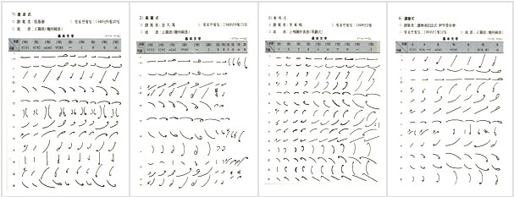
Evolution of Korean Stenography
Graphic shorthand
Until 1998 usually used
Dongbang
Euihoe
Goryeo

Slide 5
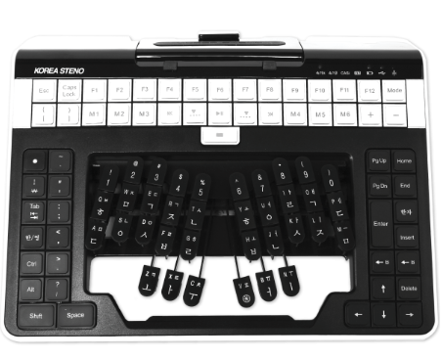
Evolution of Korean Stenography
Computer Aided Stenography
Since 1994 usually used
Making live text using keyboard and computer without additional correction
License “Hangul Stenography (Computer)”
Live video subtitles (TV, Netflix, video files …)
ASR Technology

Slide 6
Meeting minutes
In the meeting place
Stenographers attend the meeting.
In the office
They listen the audio files repeatedly and correct their work.
They write participants’ comments, recording it with 4-5 recorders.

Slide 7
Some Difficulties
Cost of meeting minutes
(1 hour, Ulleung Island)
Attending every meetings
Most of stenographers are in Seoul metropolitan area.
It requires more costs to attend some meetings in remote places.
It is hard to find new stenographers.
Many time required to correct
It takes more time to correct precisely, listening each audio files.
Making meeting minutes | 1 hour | KRW 200,000
Business travel cost |  | KRW 400,000
Total |  | KRW 600,000

Slide 8
Koreasteno’s solution
Smart-i
Using ASR technology
(in case of the meeting can offer their audio files)
Steno Editor
It can play several audio files simultaneously and make the correction more easily.
Without business trip

Slide 9
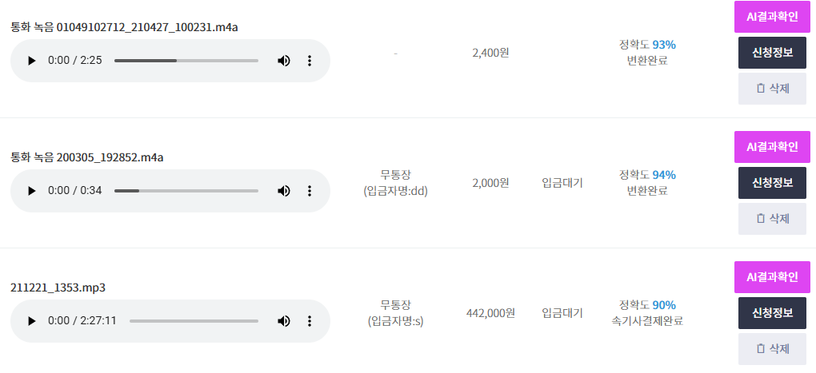
Smart-i

Slide 10
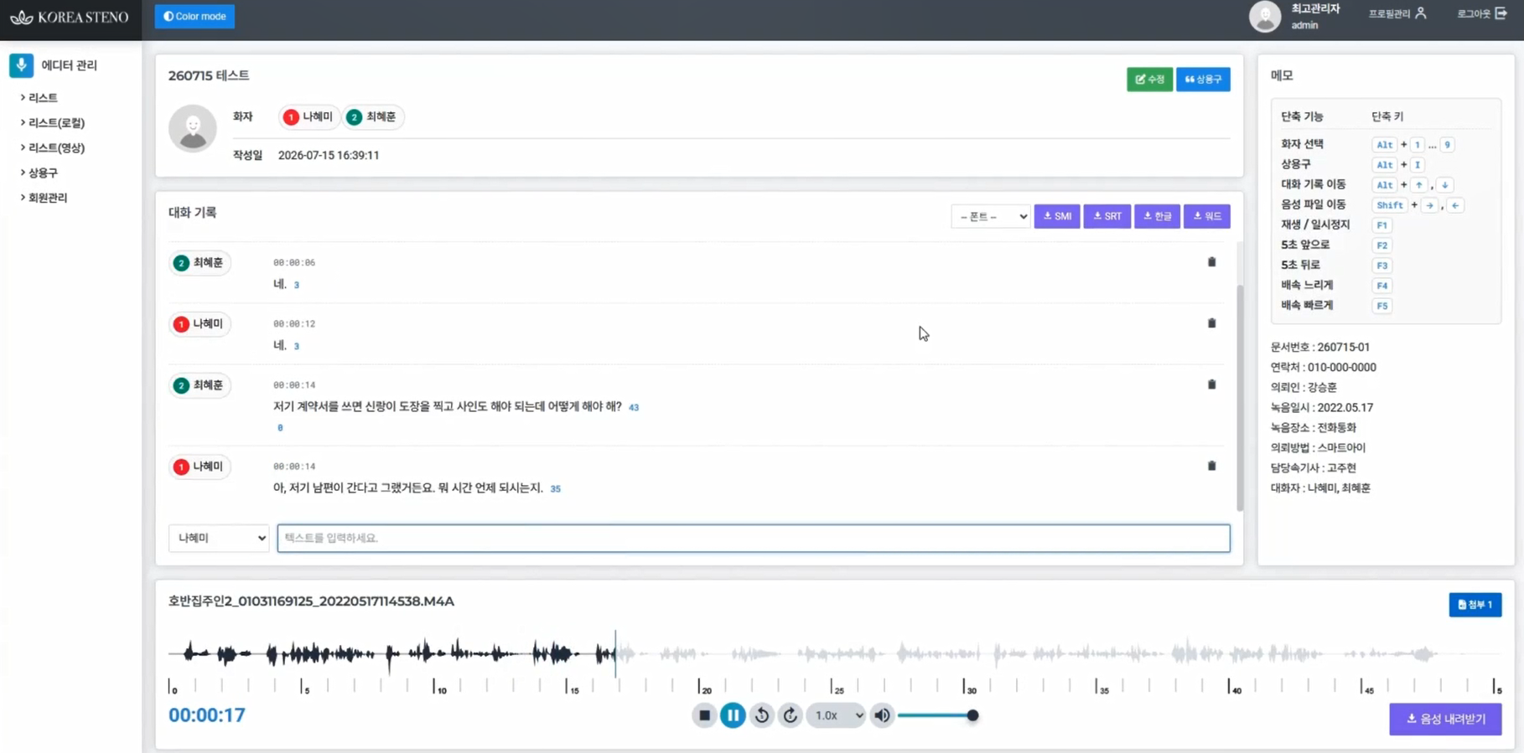
Steno Editor

Slide 11
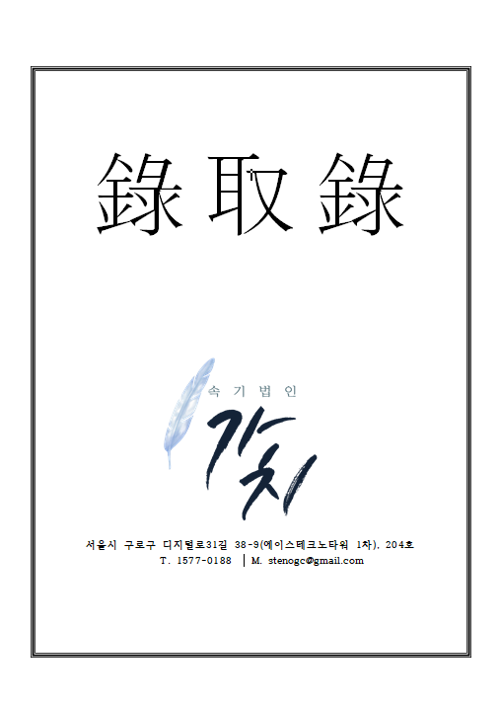
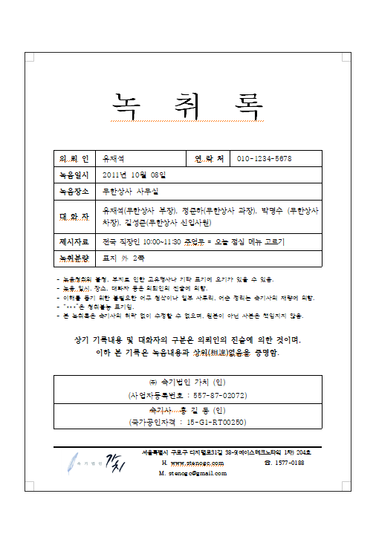
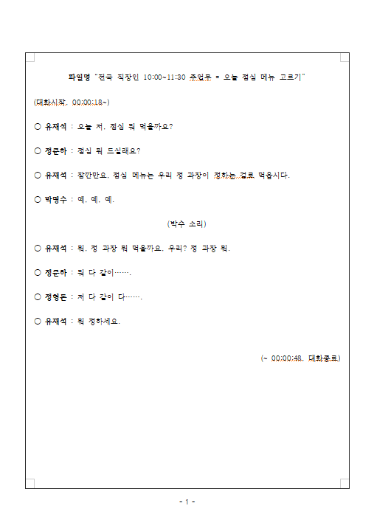
Legal transcription
Required Time of making 1-hour Legal transcription
 | Without ASR and other services | With Smart-i and Steno Editor
Stenographer A | ~ 3 hours | ~ 1.5 hours
Stenographer B | ~ 3.5 hours | ~ 2 hours
Stenographer C | ~ 4 hours | ~ 2.5 hours

Slide 12
Other plans in future
TV live closed caption
Using ASR technology
Using stenographers more efficiently (4 → 2 → 1 staffs at the same time)
Keeping high accuracy (98%)
Stenographers are still responsible for their work.
(Some crucial mistakes in TV closed caption in Korea)
The problem of the scope of responsibility arising from the use of ASR and development of work process requires more social discusstion.
(e.g. absence of stenographers in the meeting place, tolerance range of mistakes in TV live caption)

Slide 13
Conclusion
In Korea, stenography with chord-keyboard and computer is called as “Computer Aided Stenography” (CAS)
Computer Aided Stenography is widely used, and it replaced graphic shorthand completely.
There are some attempts to use ASR technology in stenography works.
Using Computer Aided Stenography, ASR and other additional software make stenographers work more efficiently.

Slide 14
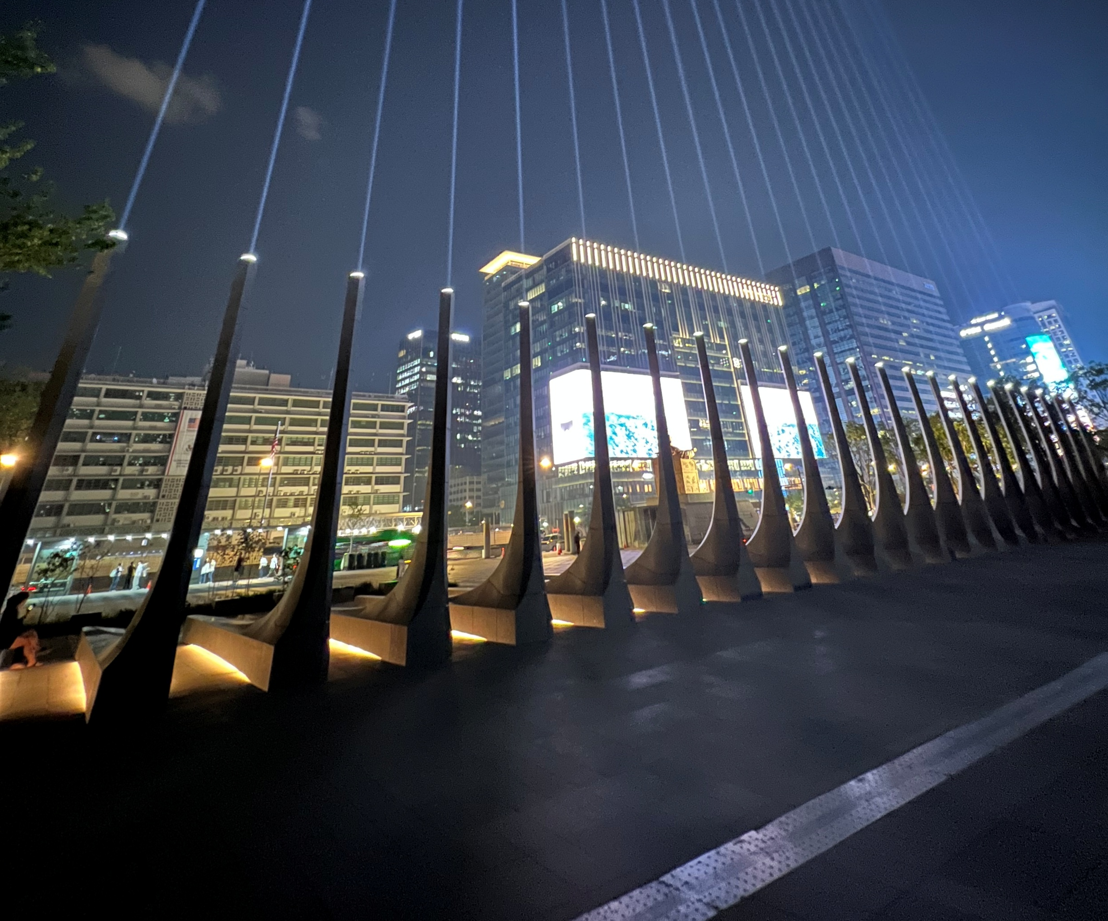
Thank you!

