Slide 1
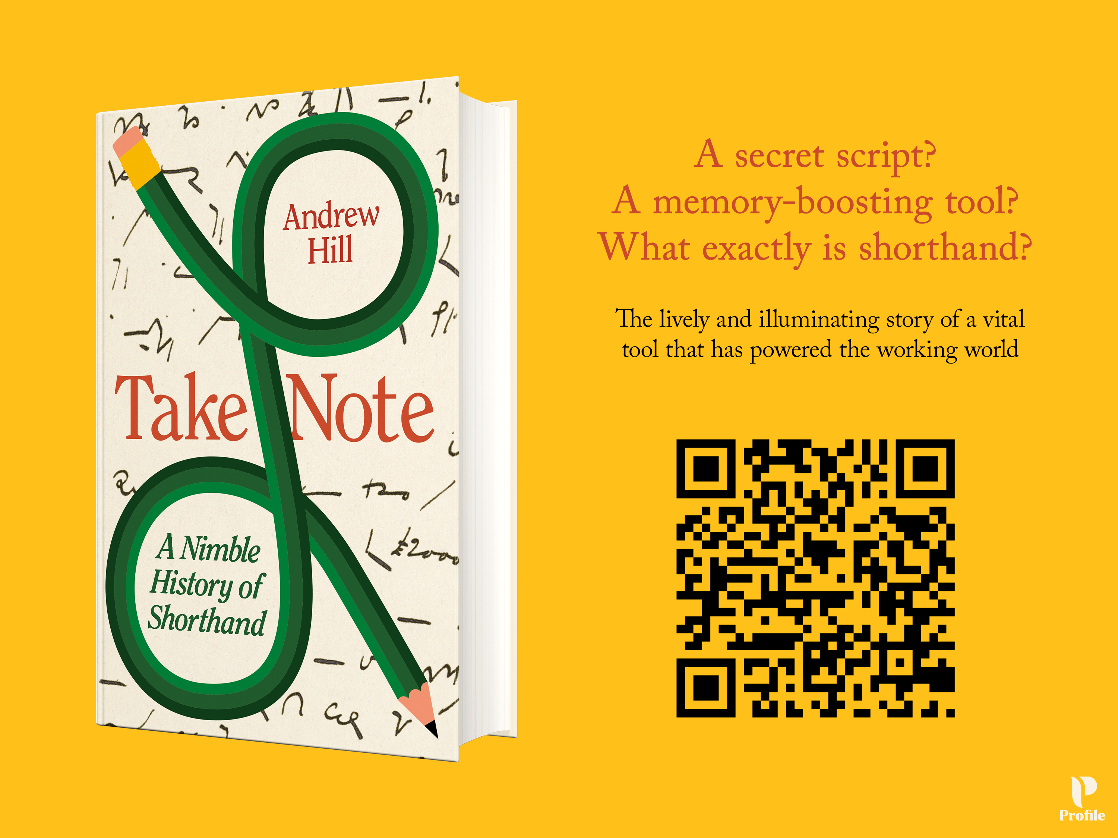
The Case for Shorthand in the Age of AI
Andrew Hill, Financial Times
Intersteno Diamesic 9, Liverpool
July 27, 2026

Slide 2
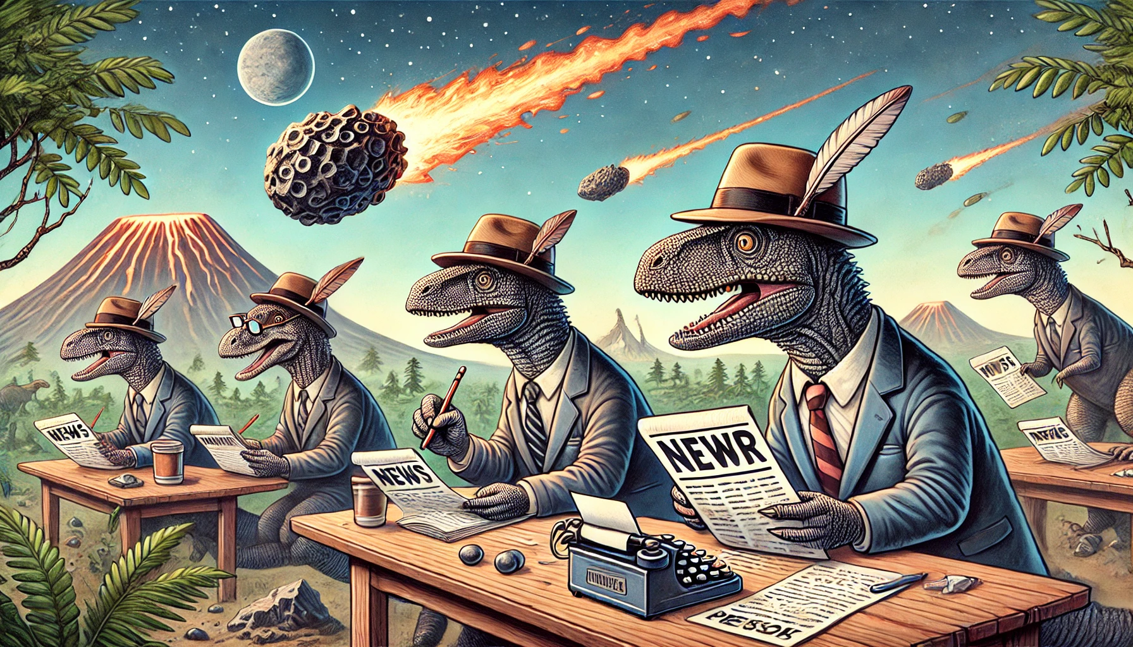
Source: ChatGPT 4o

Slide 3

Source: ChatGPT 5.5

Slide 4
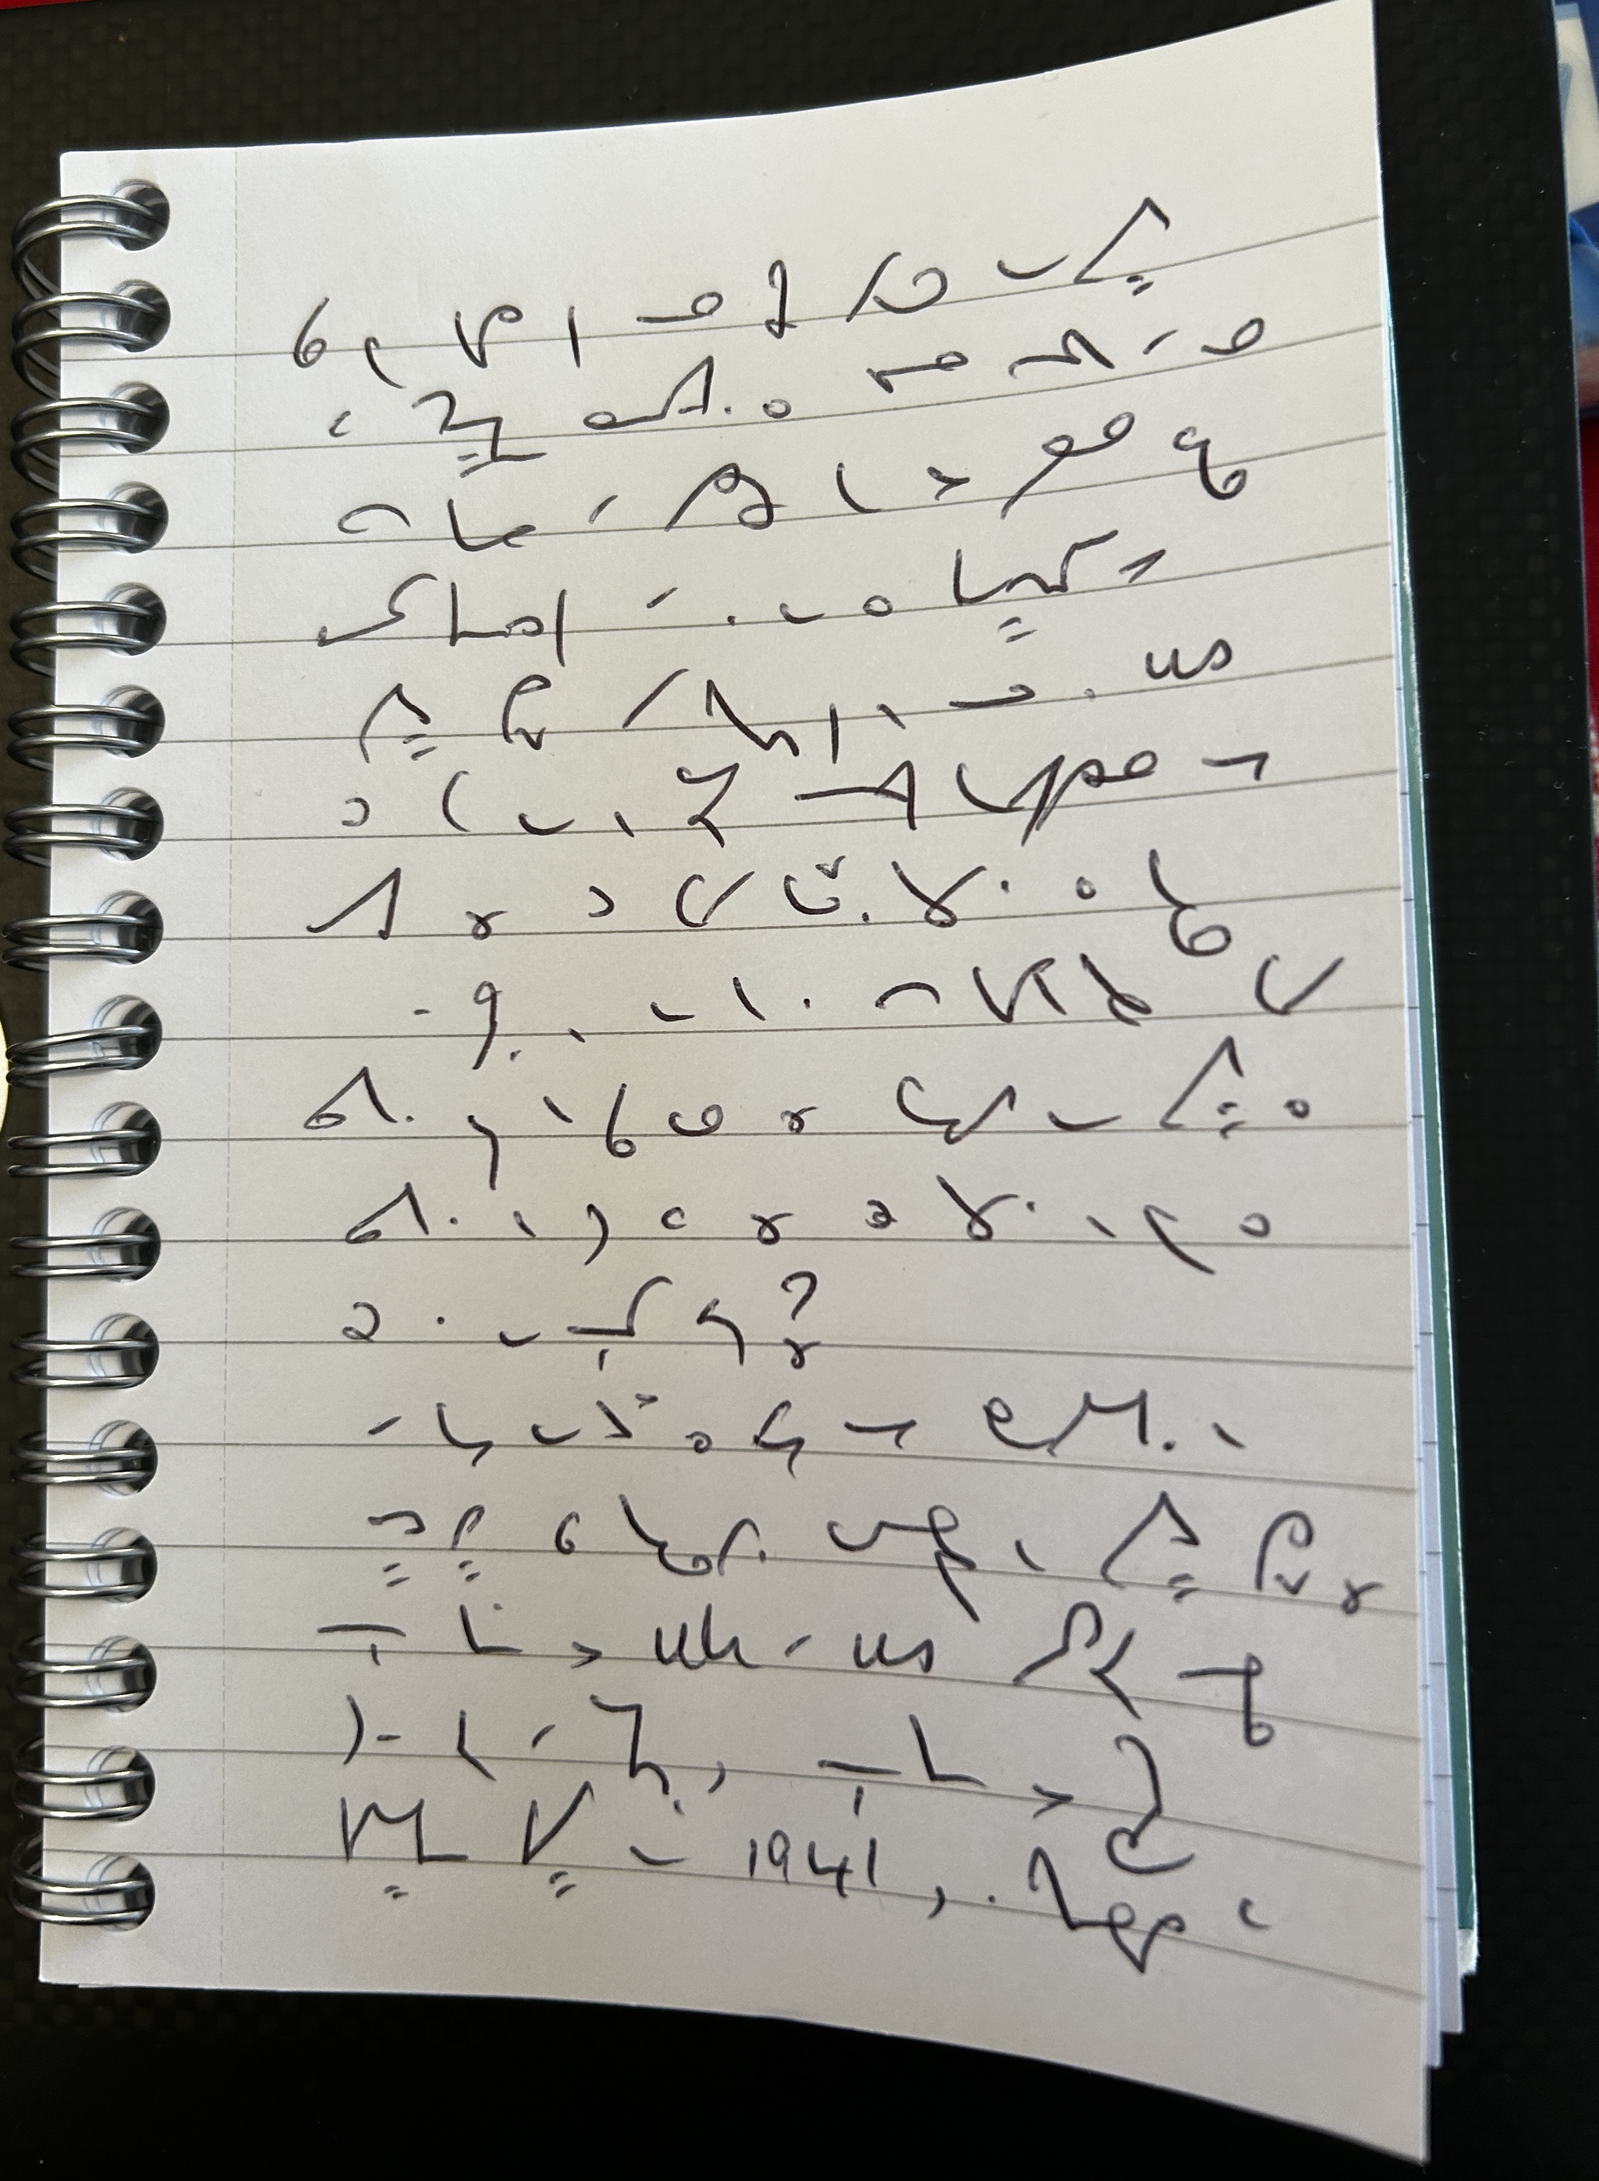
Three Pillars for Sustaining Shorthand
1. A key to the past
2. A fuel for the brain
3. A guarantee of an analogue future

Slide 5
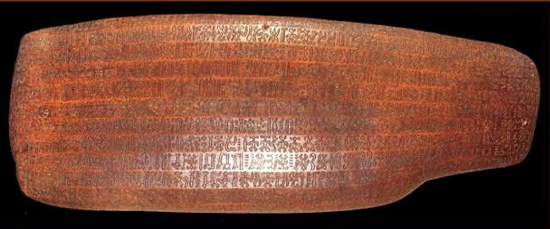
Shorthand: A Key to the Past
Lost and forgotten systems of writing:
• Rapa Nui's rongorongo glyphs — almost entirely undeciphered
• Indus valley scripts — 5,000+ signs still mysterious
• Cypro-Minoan syllabary, Banpo symbols, Wadi el-Hol inscriptions
• Languages disappearing with their final speakers
Shorthand could share this fate. Most shorthand manuscripts have never been read.
Source: Catherine Orliac and the Congregation of the Sacred Hearts of Jesus and Mary

Slide 6
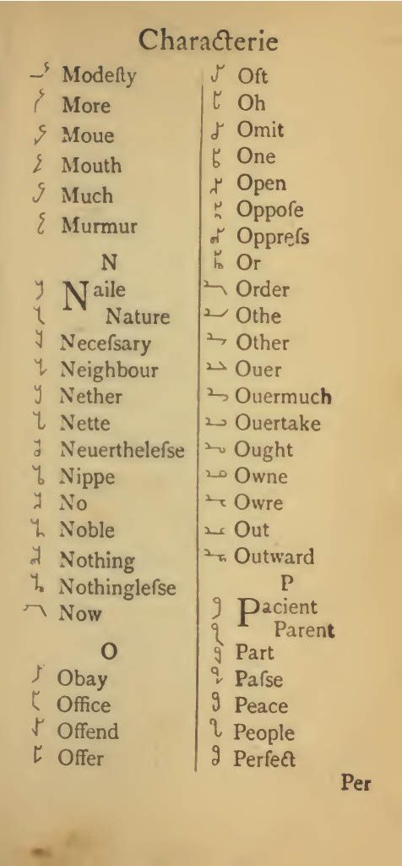
Page from Timothy Bright’s ‘Characterie’ (1588)

Slide 7
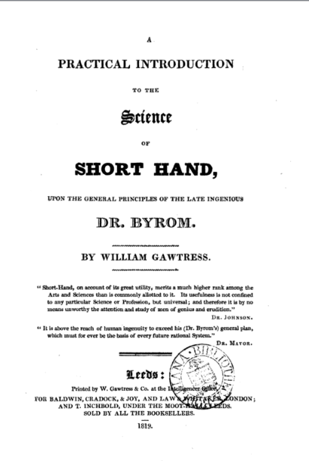

Slide 8
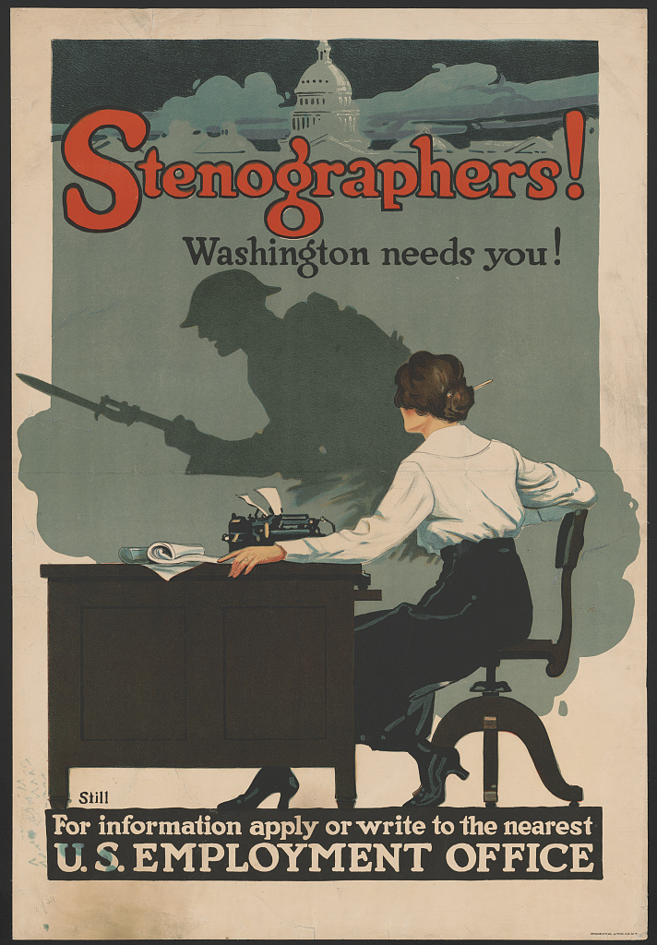
Source: Library of Congress

Slide 9
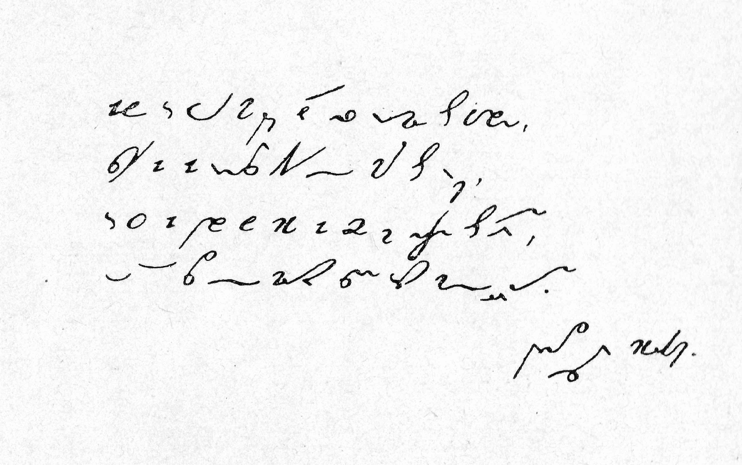

Slide 10
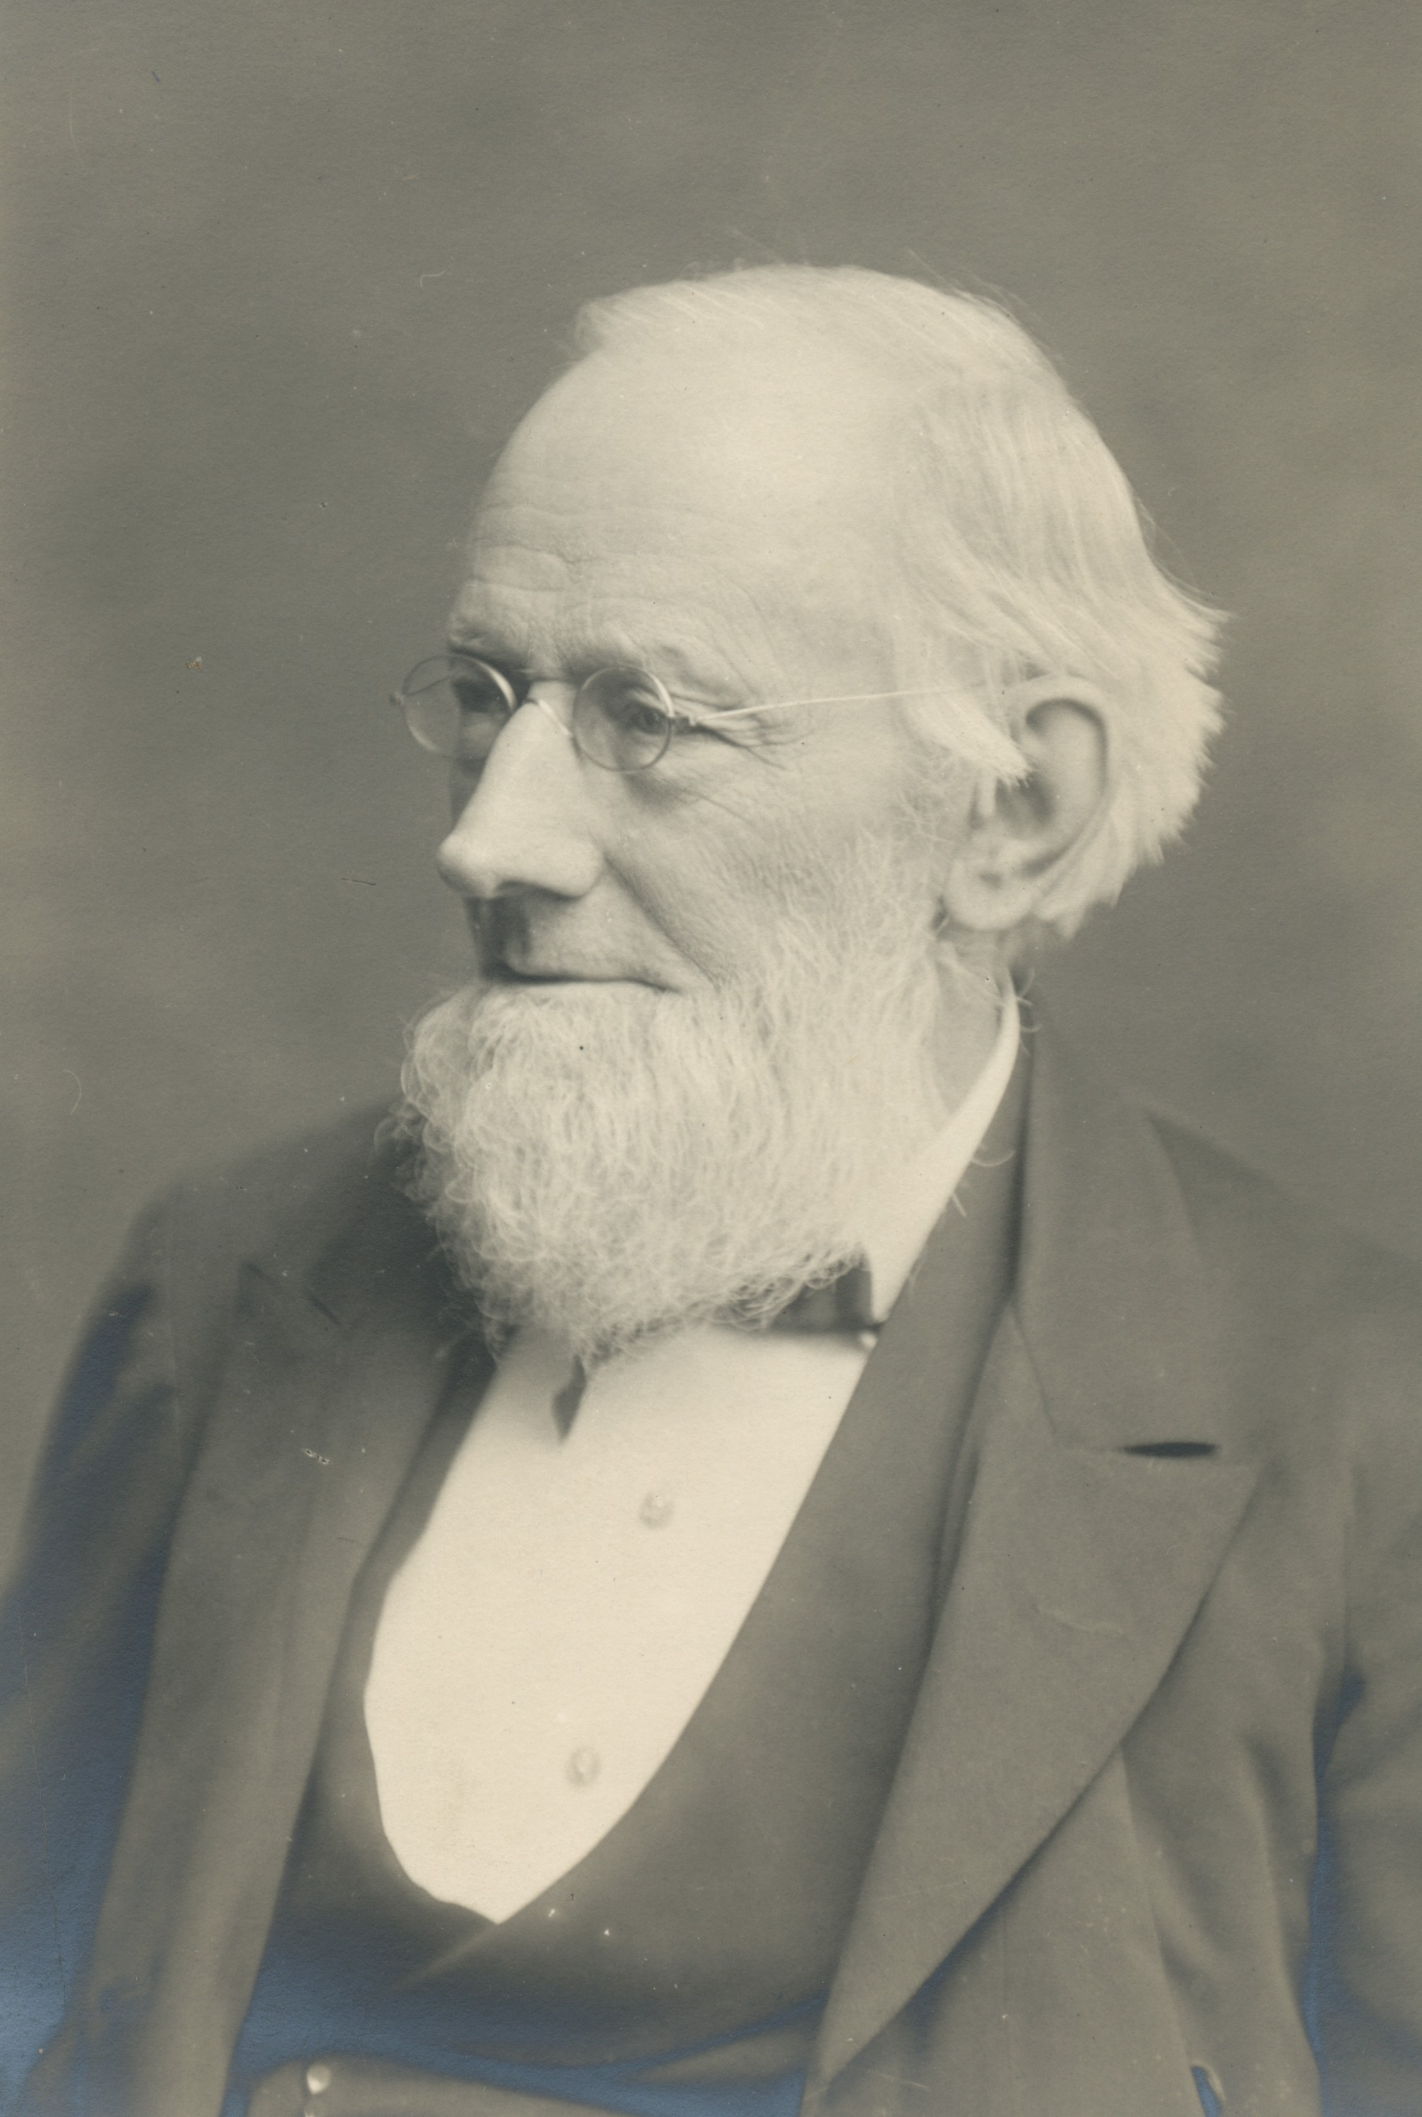
Sir Isaac Pitman (1813-1897)
“Time saved is life gained”
Source: Pitman Collection, University of Bath

Slide 11
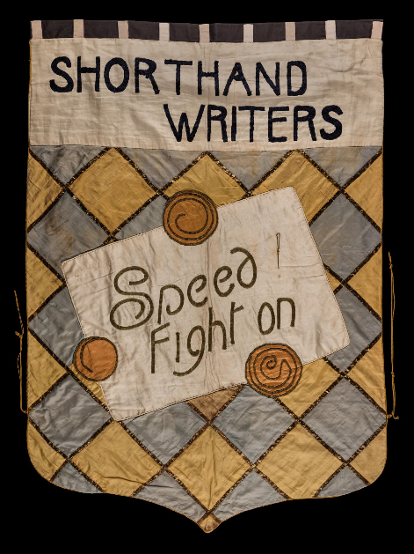
Women’s suffrage banner, 1908
Source: LSE Library

